Slide 1


The UBC Divestment Story
March 2021
Presented by Climate Justice UBC
Notes:
Chloe
Hi everyone! Thanks for joining us for the UBC divestment story presentation.
This presentation is being recorded to share later as a resource for others
The slides have been shared in the chat by Sam as well as the transcript of our presentation
You can participate with your video on or off, whichever is more convenient.
Captions are available through the zoom call if you select “turn on captions” at the bottom of your screen. You can send Samuel Munn a message if you need anything tech-related!
We will have several 5 minute breaks in between sections, so if you have questions along the way this is a time ask questions but also to stretch if needed!

Slide 2


We acknowledge that this gathering takes place on the unceded, traditional, ancestral and occupied homelands of the xʷməθkwəy̓əm (Musqueam).
For those who are non-Indigenous, our presence on these lands is an ongoing act of colonization. When we acknowledge these territories, we also acknowledge our responsibility to centre and support Indigenous sovereignty in all our organizing and being.
Notes:
Chloe
We acknowledge that this gathering takes place on the unceded, traditional, ancestral and occupied homelands of the xʷməθkwəy̓əm (Musqueam) people. For those of us who are non-Indigenous, our presence on these lands is an ongoing act of colonization. When we acknowledge these territories, we also acknowledge our responsibility to centre and support Indigenous sovereignty in all our organizing and being.

Slide 3
Climate Justice UBC is a collective of students that advocate for just, people-powered solutions to the climate crisis.
Notes:
Chloe
Today’s event is being organized by CJUBC. Formerly known as UBCC350, Climate Justice UBC is a student-run climate justice group on campus. Since 2012, we have been taking collective action on issues related to climate policy, Indigenous sovereignty, and fossil fuel divestment in an effort to hold UBC administration and the wider community accountable for inaction on climate change.

Slide 4
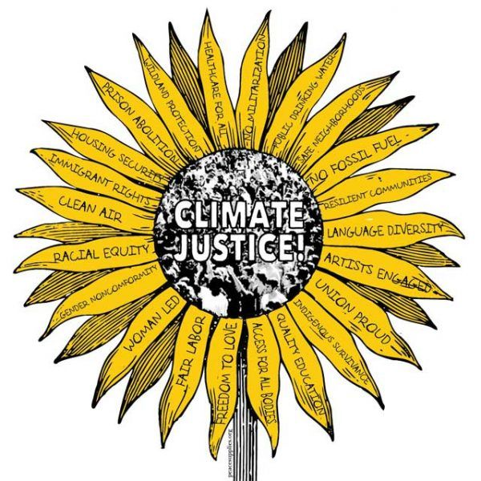
What is climate justice?
Notes:
Chloe
Climate Justice UBC organizes using a justice framework. Meaning that we acknowledge the colonial, capitalist, patriarchal, cisheteronormative and racist systems that are complicit in the creation of our current climate crisis. We also have a strategic and moral obligation to dismantle these systems in conjunction with our efforts to mitigate climate change.

Slide 5
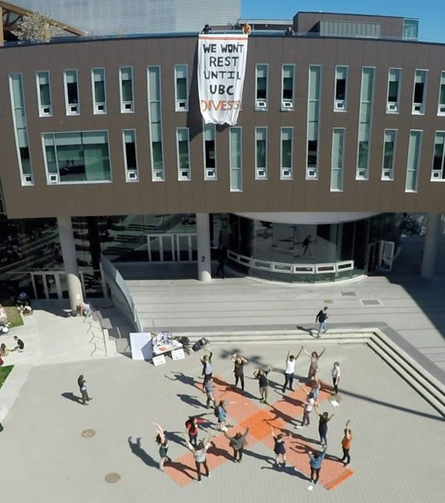
Overview
Divestment 101
Divestment at UBC: The Full Story
Reflections
Where are we now?
Notes:
Chloe
Today we’ll be talking about one of our longest ongoing campaigns: divestment. In December 2019, you may have heard the news about the Board of Governors’ decision to divest from fossil fuels. This was a huge victory for CJUBC as well as the numerous other campus groups and individuals who were working on this SEVEN year long campaign! Through this presentation we hope to give you a sense of the global divestment movement as a whole, but we’d also like to zero in on some of the lessons we’ve learned while working specifically on divestment at UBC. We’ll start off with a 101 on divestment, then we’ll go into the full story of the campaign, followed by some reflections on how we achieved this victory and the significance of this movement. We’ll cap it off with some info about what we’re working on now.

Slide 6
We will have some time for group discussion in between sections.
Feel free to ask questions or share comments during this time.
You can type into the chat or “raise your hand.”
Notes:
Chloe

Slide 7
Divestment 101
Notes:
Anna

Slide 8
What is divestment?
The opposite of investment:
Withdrawing investment funds (e.g. stocks or bonds) from a specific industry or company,
often for ethical purposes
Notes:
Anna

Slide 9

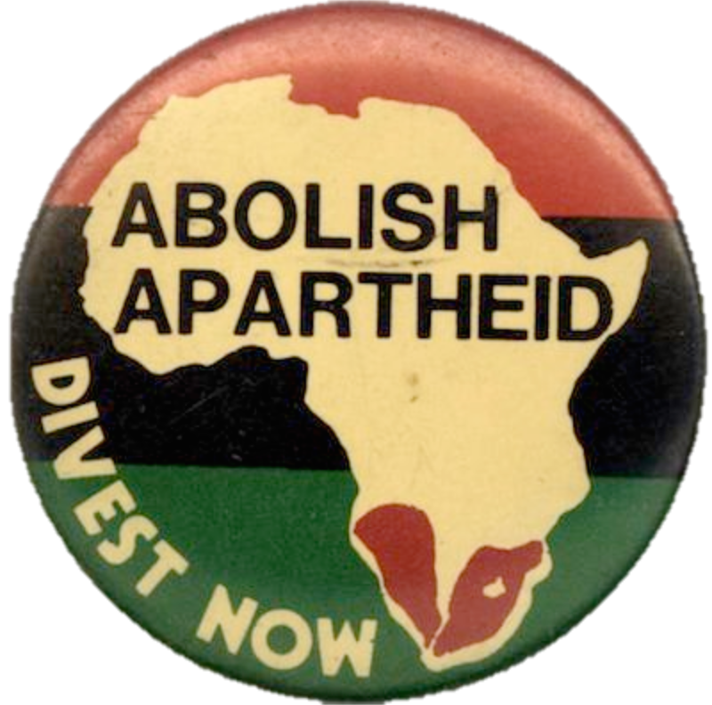
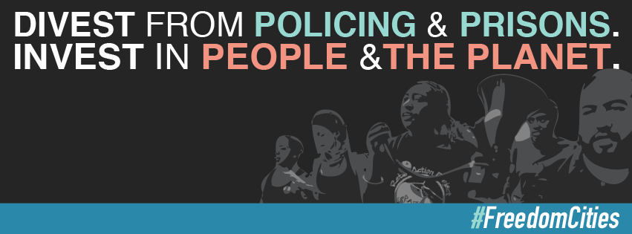

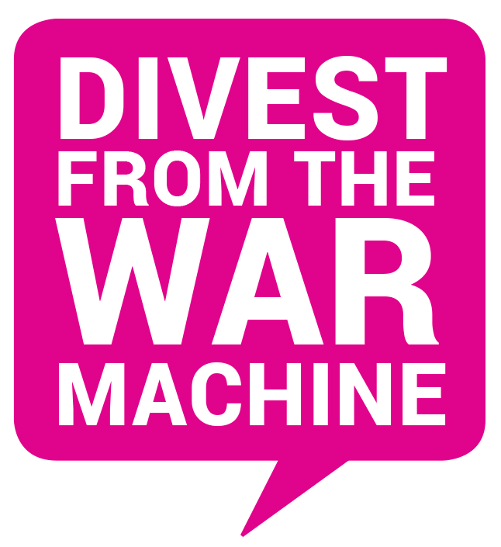
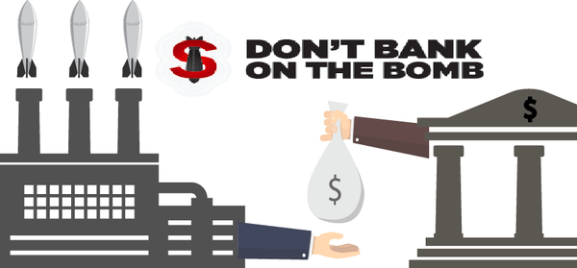
Notes:
Anna
Precedents, divestment is not a tactic unique to this movement
History of student activism (south african apartheid)
In the past, divestment has been used as a tactic in sanctioning the tobacco industry, abolishing apartheid in South Africa, and deconstructing the prison industrial complex in America. Churches and other religious institutions have also historically practiced divestment by divesting from “sinful” industries such as pornography or weapons and arms.
Mining
Also very recent divestment movement aimed at Larry Fink, a board member at Museum of Modern Art (MOMA) and Blackrock CEO; Blackrock is a huge investment company and one of the (the?) largest investor in private prisons, beef agribusiness, fossil fuels, arms companies and other harmful industries. -Max

Slide 10
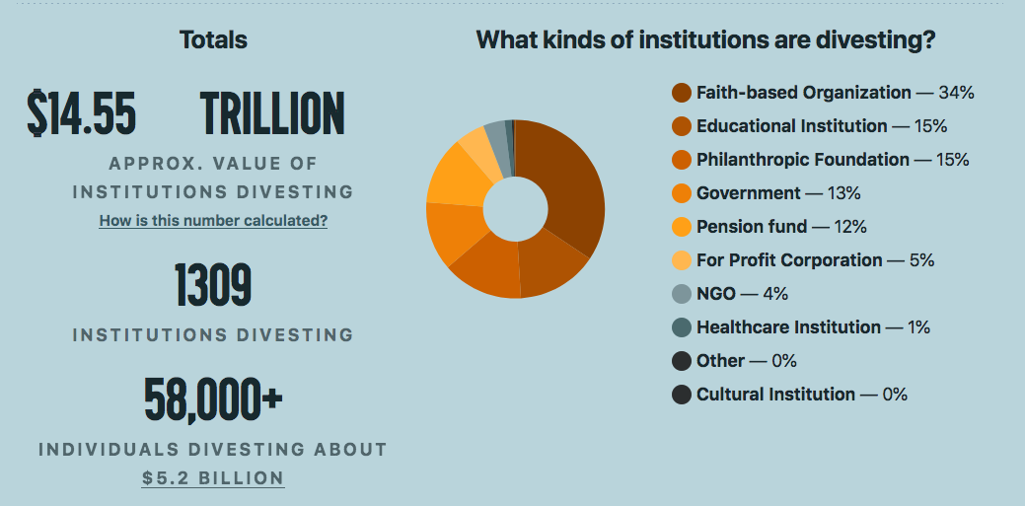
Notes:
Anna

Slide 11
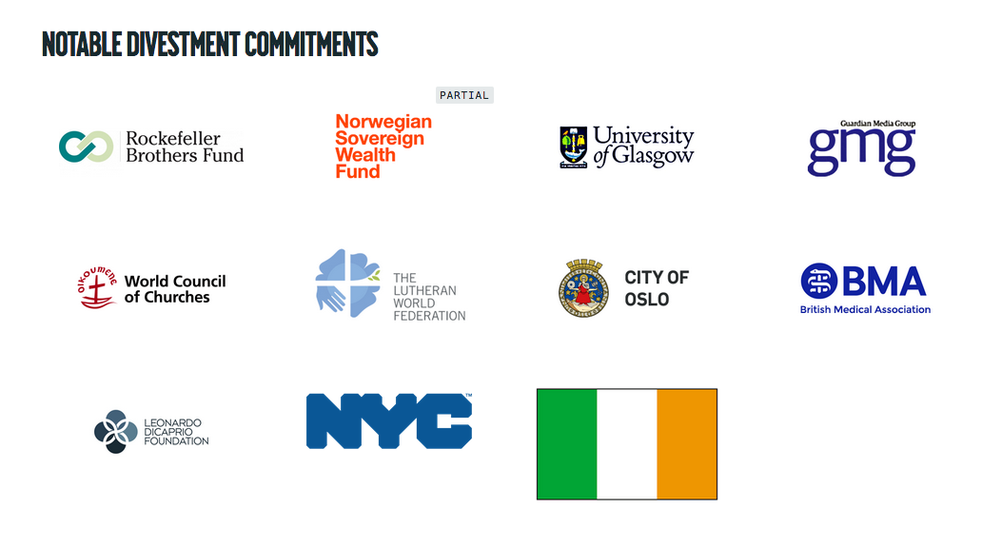
Notes:
Anna

Slide 12
Why do we target the fossil fuel industry?
Notes:
Anna
Overall this is about keeping the companies most responsible for the climate crisis accountable for the harm they have caused.

Slide 13
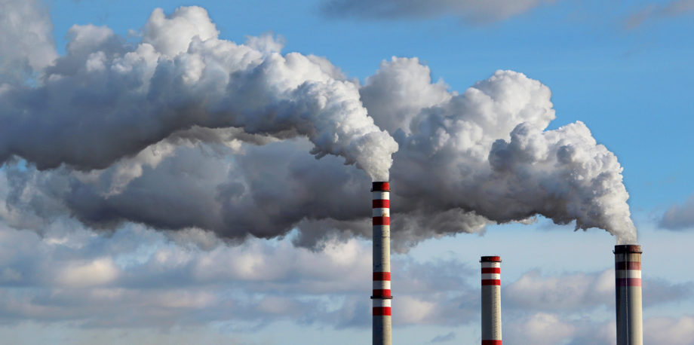
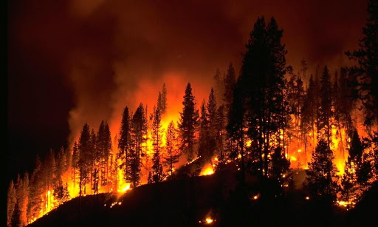
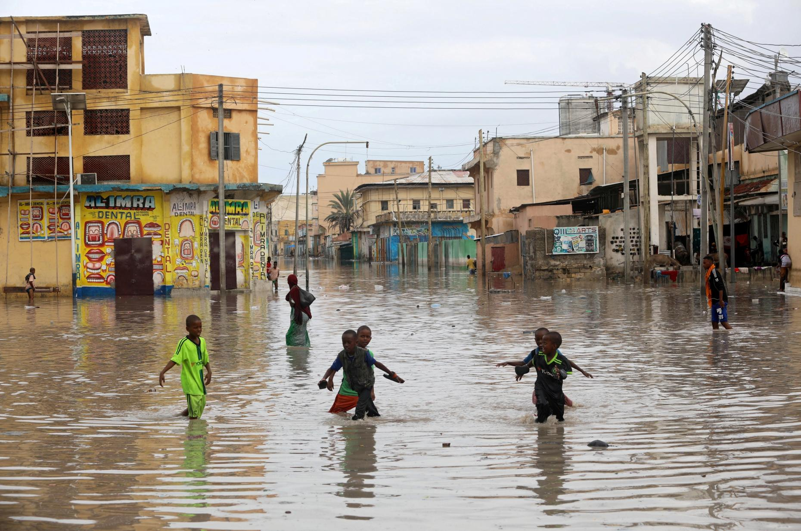
The fossil fuel industry is a key driver of the climate crisis
Notes:
Anna
As we all know, we are in the middle of a global climate crisis. In 2019, the Intergovernmental Panel on Climate Change reported that we have barely a decade left to make a radical shift in the way we treat our planet. Climate change is not an issue for future generations to shoulder.
(For those of us who might think climate change is an issue for future generations to shoulder, it is important to know that rising temperatures and sea levels have already led to the displacement of millions of people most of whom were not responsible for the emissions that are causing these problems. Projections show that even with the most ambitious carbon reduction pledges, it will be a struggle to bring emissions down to a liveable level. Failure to do so will result in the disproportionate destruction of humans and nature, and it will affect the most vulnerable and least responsible populations first. In Canada, these populations mostly include Indigenous peoples and racialized communities.
This crisis becomes increasingly imminent with every day that passes, and this can be seen tangibly in our atmosphere’s carbon composition. Carbon dioxide levels have been rising rapidly since the industrial revolution, and scientists locate the extracting and burning of fossil fuels as at the heart of this crisis.
Climate justice - costs and benefits distributed disproportionately based on existing systems of oppression

Slide 14

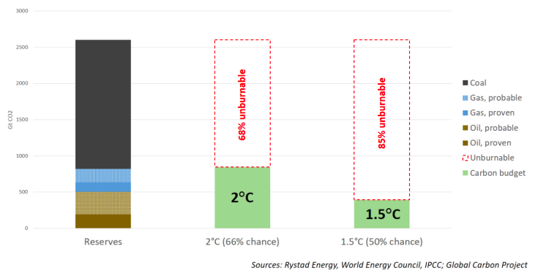
The fossil fuel industry is a key driver of the climate crisis
Fossil fuel reserves vs carbon budgets
Notes:
Anna
Fossil fuel business model is at odds with international climate targets. 85% of their reserves are unburnable if we are to stay within 1.5 degrees. We need to keep it in the ground.
Indigenous communities and scientific experts have been advocating for a radical shift in practice for the last several decades. You may have encountered the phrase “keep it in the ground”. This refers to the analyses that have been done which estimate the percentage of remaining coal, oil, and gas reserves that must be left in the ground in order to prevent a 2 degree Celsius rise in global temperatures. Scientists have an impressively precise idea of how much fuel we have left to burn, and it isn’t much. The divestment movement hinges on the idea that fossil fuels are a dying industry because there is an extremely limited amount of them left that we can safely burn. Arguably, we passed the point of “safe burning” quite a long time ago and are now in damage-control mode instead.

Slide 15
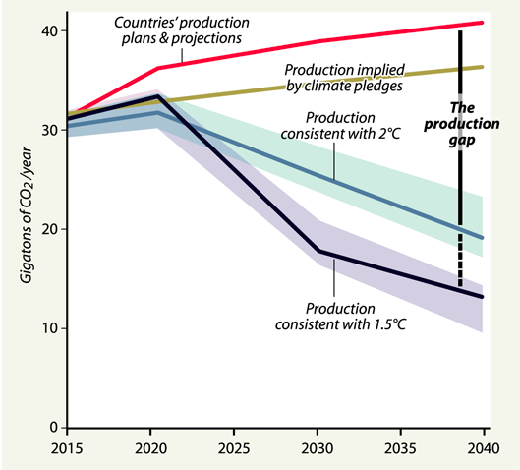
The fossil fuel industry is a key driver of the climate crisis
Notes:
Anna
The Production Gap report shows that:
To follow a 1.5°C-consistent pathway, the world will need to decrease fossil fuel production by roughly 6% per year between 2020 and 2030.
Countries are instead planning and projecting an average annual increase of 2%, which by 2030 would result in more than double the production consistent with the 1.5°C limit.
Politicians and businesses often prefer to focus on “demand side reduction” (reducing energy use), which is no doubt very important, but often this distracts from the problem of ever increasing fossil fuel production. We drastically need to reduce the supply of fossil fuels and replace with alternative energy solutions.

Slide 16
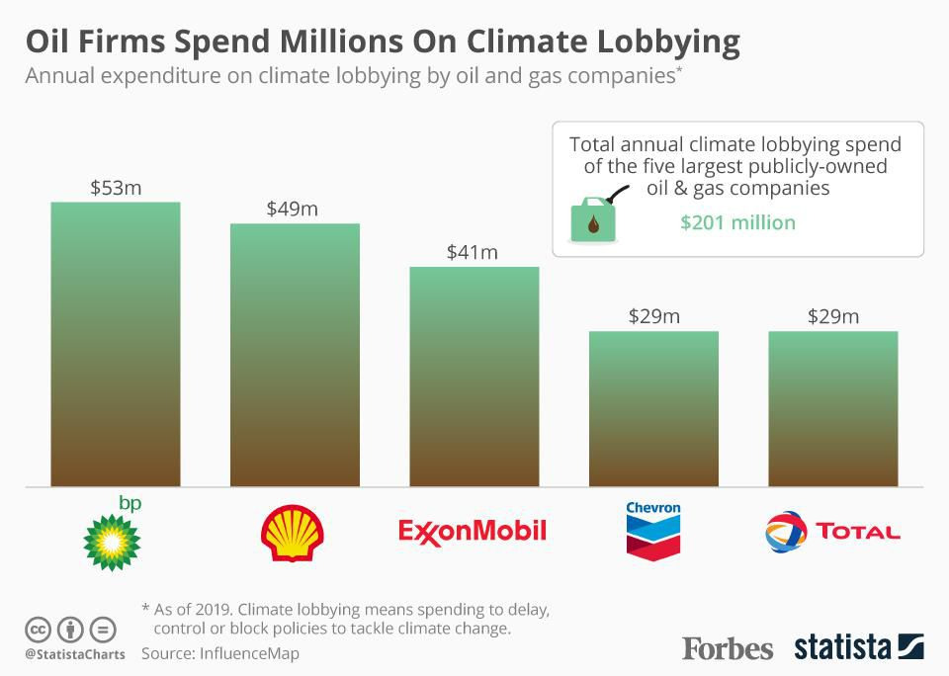
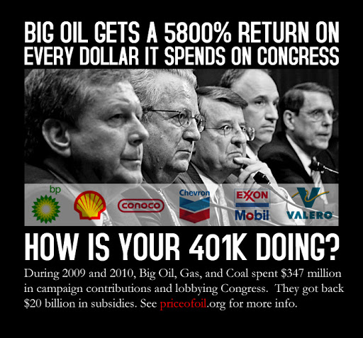
2) The fossil fuel industry has actively blocked climate action for decades & continues to do so
Notes:
Anna
Fossil fuel companies have actively blocked climate action for decades through lobbying, misinformation campaigns, political donations and unfounded political influence. They are a key barrier to climate policy.
The industry responsible for this has known about the fatal implications of climate change since the 1970s, when Exxon first started to generate false narratives around climate change in an effort to divert attention away from the negative impact of fossil fuels. Soon enough, companies like Shell and BP joined in, worried that climate action would destroy their infrastructure. Since 2015, the top 5 oil majors alone have spent over 1 billion in misleading anti-climate action campaigns.
Fossil fuel companies knew since the 70s
They have cast doubt on science and misled the public
They have lobbied and donated to politicians to block climate action
They did this all for profit

Slide 17
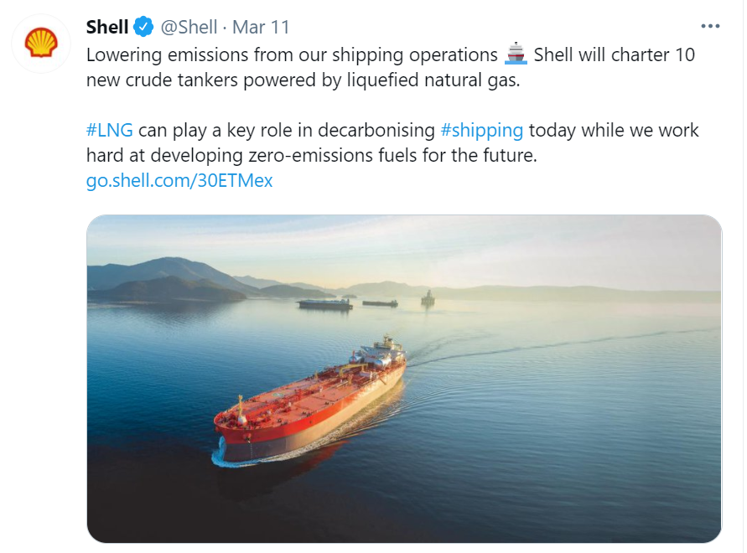
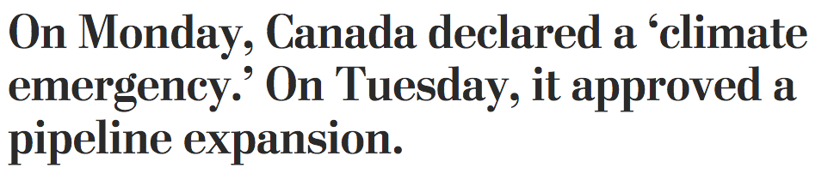
2) The fossil fuel industry has actively blocked climate action for decades & continues to do so
Notes:
Anna
Even though fossil fuel companies accept that the climate crisis is real now, they still mislead the public to believe that fossil fuels can be part of the climate solution → new form of climate denialism
Politicians act like we can have it both ways. They prioritize fossil fuel company profits at the expense of everyone else and then pretend like they are taking climate action
The fossil fuel industry has too much power over climate policy!
The purpose of the divestment movement is to call out this contradiction!

Slide 18
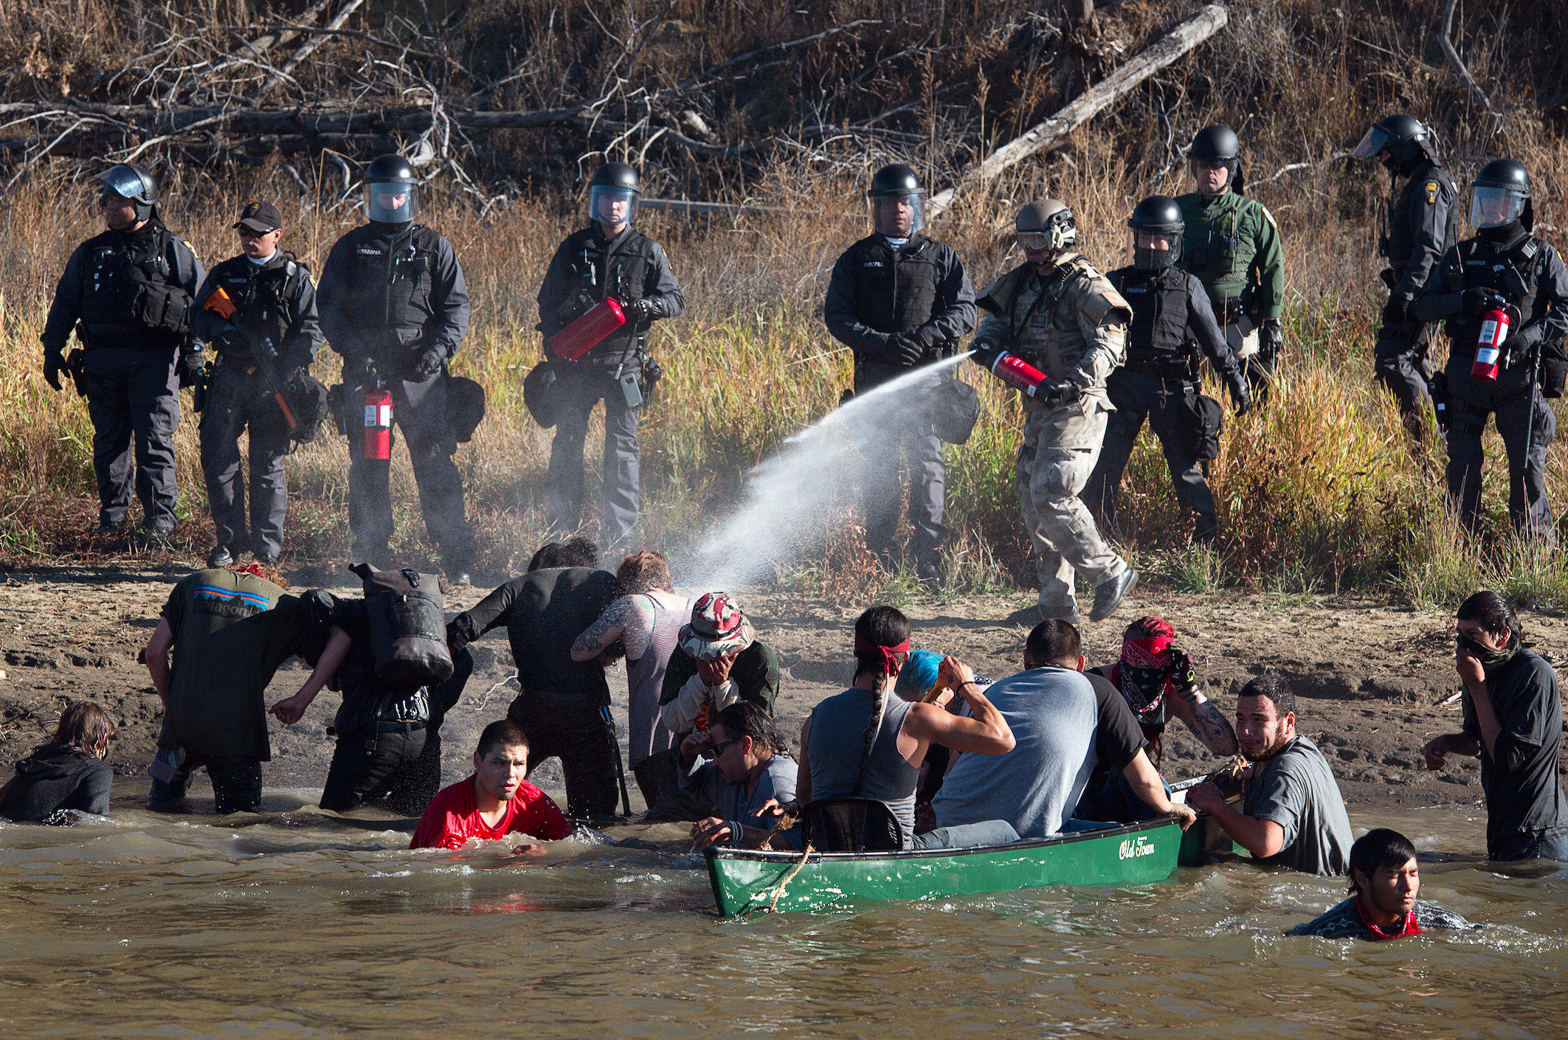
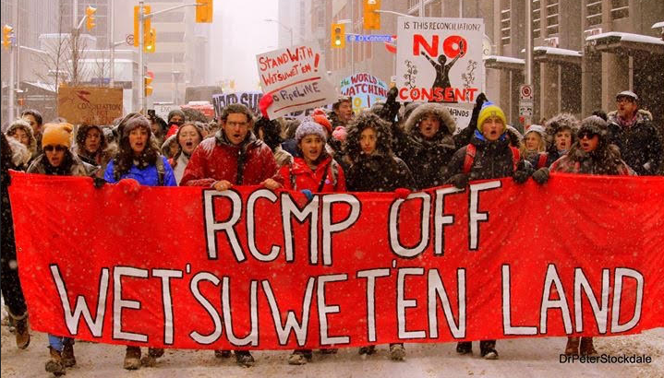
3) The fossil fuel industry is a key perpetrator of racial and colonial violence
Notes:
Anna
This is not even just about climate change. Fossil fuel companies are the biggest criminals when it comes to Indigenous rights, MMIW, man camps, environmental racism & land/water/air pollution in communities of colour
In December 2019, The Guardian reported that the RCMP were prepared to deploy snipers and shoot Wet’suwet’en land defenders for blocking construction of the Coastal GasLink pipeline on their unceded territory. Indigenous peoples have always been at the forefront of climate leadership advocating for the last several decades and colonial violence continues to be enacted upon Indigenous lands and bodies until today.

Slide 19
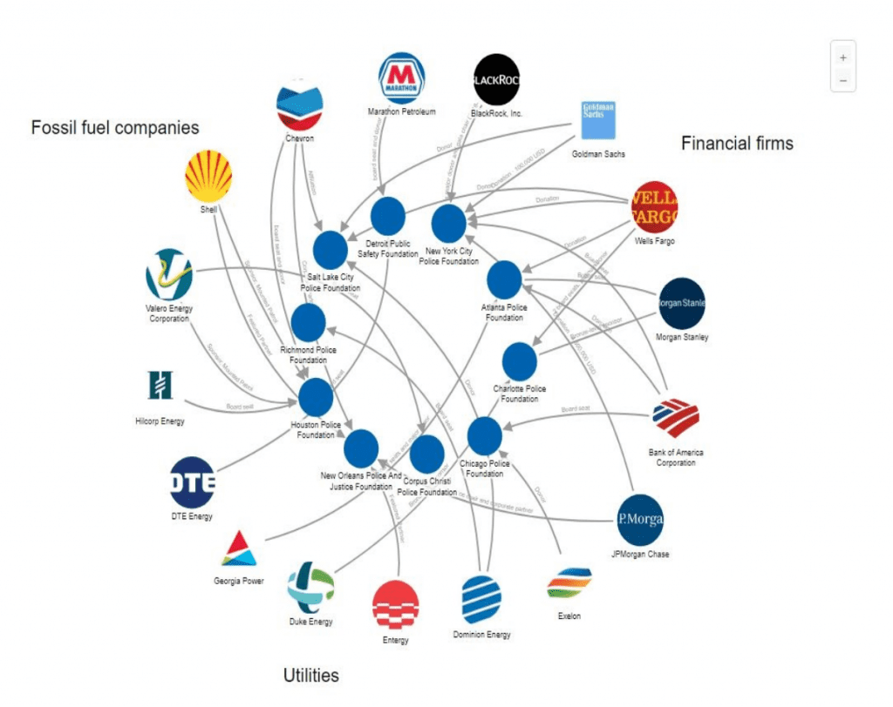
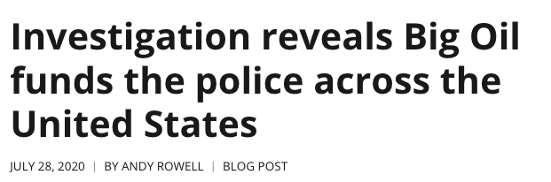
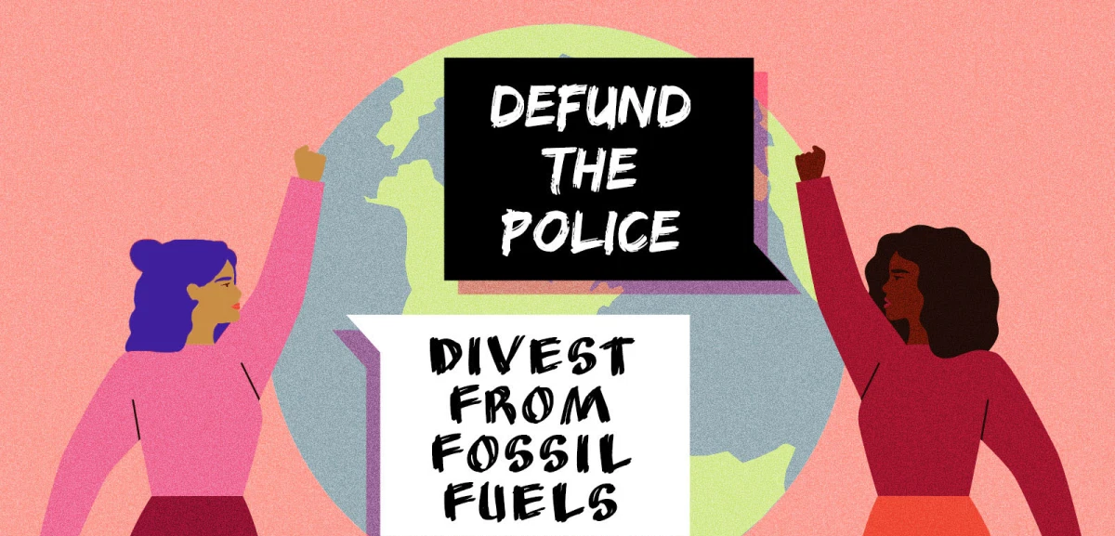
3) The fossil fuel industry is a key perpetrator of racial and colonial violence
Notes:
Anna
Fossil fuel companies finance police foundations which are used to buy additional weapons and surveillance technology. They also pay security forces to arrest and intimidate water protectors (this is happening with Line 3 right now: https://heated.world/p/i-dont-feel-safe-here )

Slide 20

Fossil Fuel Industry
Media
Police
Business
Education System
Govern-
ment
Financial System
Arts & Culture
Public opinion & social license
Notes:
Anna
Social view of power - power doesn’t run from the top down, it is upheld by pillars of social support. The goal of a social movement is to knock down these pillars - in other words, withdrawing consent.
The fossil fuel industry is upheld by many societal pillars, shown here. These pillars are in turn upheld by public opinion or “social license”
Social license refers to the acceptance of an industry, company or project granted by stakeholders and the general public. It is necessary for companies to stay in business.
Universities like UBC are active in upholding the different pillars - e.g. research, eduction, investments, media, etc. They lend credentials to the industry, provide research support, train new generations of workers & citizens, etc.
Universities also play a role in shaping public opinion/social license - universities act as both an academic authority and a moral reference point. What universities say matters.
Divestment aims to highlight the complicity of institutions we have a stake in in order to bring light to the injustice of the fossil fuel industry
So, divestment in terms of the climate movement looks like removing stocks and bonds from companies that are implicated in the production and burning of fossil fuels. However, there is a common misconception around the purpose of divestment, and dismantling this myth is one of the main reasons we’ve created this presentation. Divestment is NOT about destabilizing the fossil fuel industry financially. We know that one institution like UBC removing their investments, or even every university in Canada doing so, won’t have a huge economic impact on the industry. However, we do know that money is a universal language that our target stakeholders understand and prioritize. Where people choose to invest their money has huge social implications beyond the financial impact. When a leading institution like UBC chooses to pull their money from an entire industry for ethical reasons, society takes notice, and it sends the message that supporting fossil fuels production is no longer the norm.
There’s a prevalent narrative in organizing spaces that institutions are evil or that they’re the bad guy in terms of making progress, but this is one area where institutional actions can have an incredibly meaningful impact. It’s not only schools that have successfully divested; faith organizations, governments, and for-profit companies like Ben and Jerry’s have also divested. In this way, divestment is a worldwide movement that puts the onus on those with the most economic power to make change, rather than relying on the working class to make further sacrifices.
Pillars
Government - subsidies, regulation, permits, taxes/royalties
Businesses that sell their products, enter contracts with them, etc.

Slide 21
Divestment Theory of Change
If we organize enough students to demand divestment, then our universities will have no choice but to divest.
If enough campuses divest from the fossil fuel industry, then public opinion will shift against the fossil fuel industry.
If public opinion shifts away from support of the fossil fuel industry, then the fossil fuel industry will not be as powerful, and we can build a more just future.
Notes:
Anna
Divestment aims to remove the social license of the fossil fuel industry by forcing institutions we have a stake in to take a stand. By delegitimizing the fossil fuel industry, we will remove its political influence, thus dismantling one of the key barriers to climate action. Without the fossil fuel industry holding our politicians captive to their interests, politicians will listen to the community instead. They will implement the necessary policy change, winding down fossil fuel production and ushering in the transition to a just and sustainable economy.
The purpose of divestment is not necessarily the removal of funds from the fossil fuel industry (because our universities don’t have enough invested to bankrupt them directly) but the broader social and political impact, which holds the power to lead to the industry’s demise.
So, divestment in terms of the climate movement looks like removing stocks and bonds from companies that are implicated in the production and burning of fossil fuels. As I mentioned earlier, fossil fuel companies have huge lobbying power and are not afraid to spend millions on misleading propaganda. These are the wealthiest and most powerful companies on the planet, and they’re using their money to block every serious attempt to stop climate change. Despite the atrocities that Big Oil commits daily, there is a lack of public condemnation for these companies, which is slowing the progress of government structures which could otherwise be legislating strict regulations on the industry. By convincing institutions like UBC to divest, desponsor, and defund fossil fuels, we can turn the tide of public opinion against companies like Exxon and Shell. Divestment campaigns aren’t just about winning a “yes” on divestment. They’re about telling the stories of successful collective actions against a massive industry built to resist exactly what we’re trying to achieve. By making a public statement indicating a decision to shift our money away from the fossil fuel industry, UBC would truly be walking the talk and helping shift business as usual.
So, why is it powerful for UBC to make this statement against the fossil fuels industry? As I mentioned earlier, fossil fuel companies have huge lobbying power and are not afraid to spend millions on misleading propaganda. Despite this, society continues to regard the industry as legitimate and respectable. This makes it extremely difficult for politicians and decision-makers to legislate change, because attempts to impose restrictions on the industry result in pushback that is misinformed by anti-climate action propaganda. However, when institutions make public statements that stigmatize the fossil fuel industry, it begins to turn the tide of public opinion against companies like Exxon and Shell. People are then more likely to support politicians that say no to fossil fuel infrastructure, giving us the political and social will we need to transition to a just and sustainable economy.
This is why an institution quietly transferring its money from one portfolio to another, without any public statement, isn’t the goal of divestment. The real success of divestment comes when institutions use their platform to shift business as usual, and challenge others to do the same. The divestment movement is about telling the stories of successful collective actions against a massive industry built to resist exactly what we’re trying to achieve. By dismantling the fossil fuel industry’s social license, we can make way for community-led solutions to the crisis, achieve strong climate legislation, and shift the paradigm of fossil fuel dependency.

Slide 22
Discussion Time - 5 mins
Notes:
Chloe

Slide 23
Divestment at UBC:
The Full Story
Notes:
Michelle
Now we’re going to get into the story of the campaign at UBC! But before we do that, we first want to share some context about the goals and targets of the campaign.

Slide 24
Campaign Goals
Get UBC to divest from fossil fuels
  Demonstrate that divestment can be achieved at Canadian universities
Get UBC to denounce the fossil fuel industry’s role in the climate crisis
  Leverage the University’s moral and academic authority to remove the social license of the fossil fuel industry in Canadian society
Educate and activate the campus community
  Raise awareness about the central role of the fossil fuel industry in the climate crisis
  Equip community members to advocate for systemic solutions to the climate crisis
Notes:
Michelle
There were three main goals underlying the campaign. The first of course was to get UBC to divest from fossil fuels and in doing so set a model for other universities to follow. But getting UBC to divest alone would not be enough. As discussed before, the purpose of divestment is to remove social license from the fossil fuel industry. So, the divestment announcement would need tied to the climate crisis, leveraging UBC’s moral and academic authority in condemning the fossil fuel industry. Last but not least, we wanted to educate and activate the campus community. Again, divestment is about removing social license so we needed to spread the word about the role of the fossil fuel industry in fuelling climate change. We also wanted to help people feel empowered to take action. At the time we started this campaign, most climate work focused on individual behaviour change. We recognized the limits of this approach, as it can divert accountability from institutions. We wanted to show students and other community members that we could leverage our collective power to create systemic change - changes much bigger than what an individual could can do alone.

Slide 25
UBC’s Endowment Fund
Endowment Fund
($2 billion)
Research
Donations (~75%)
Scholarships
Land Revenues (~25%)
Academic programs
Bonds
Real Estate
Returns
Stocks
Other Investments
Notes:
Michelle
So why does UBC even invest in fossil fuels? Well UBC like most universities has an endowment fund. The purpose of the endowment fund according to UBC is “to provide financial support to the university’s academic mission in perpetuity, and to further UBC’s vision to create a learning environment that fosters positive global citizenship.”
The money in the endowment fund comes from two sources: 1) Donations, which make up about 75% and 2) Land revenues, in other words leasing out stolen land UBC is occupied on, which makes up about 25%.
In total, UBC’s endowment is valued at approximately $2 billion. This is separate from the pension funds that UBC also manages.
This money is invested in a variety of assets, including stocks, bonds, real estate, etc. The returns on these investments are then used to fund various university activities including research, scholarships and academic programs. There are many endowments within the endowment fund, each with specific purposes. Any extra returns are put back into the endowment fund so it can grow over time.

Slide 26
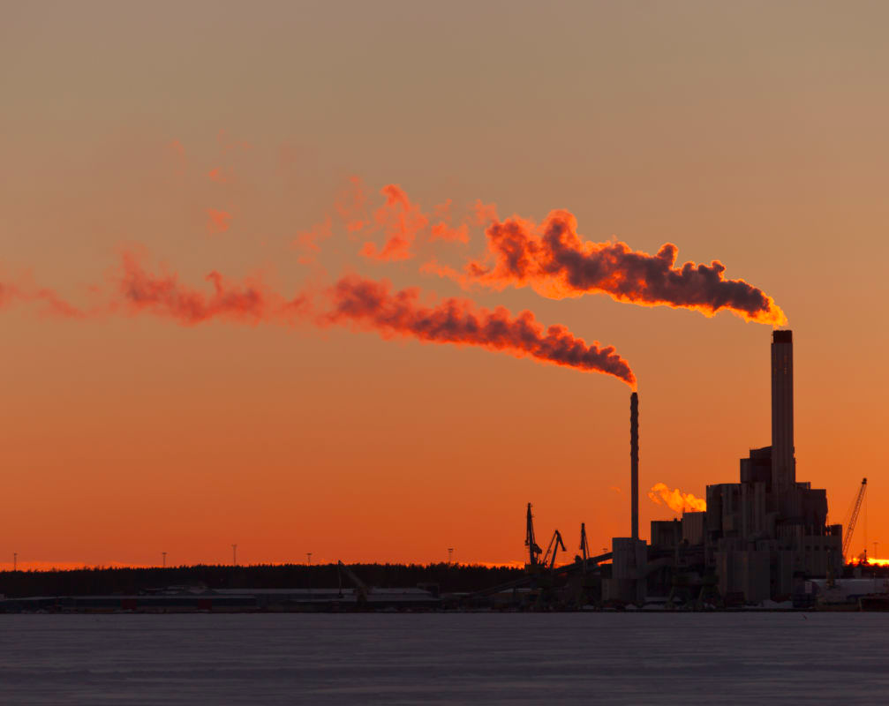

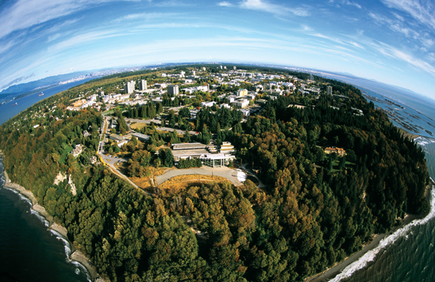
Climate Hypocrisy
Up to $85 million invested in the fossil fuel industry
Pursuing excellence in research, learning and engagement to foster global citizenship and advance a sustainable and just society across British Columbia, Canada and the world.
Notes:
Michelle
From what we know, UBC had up to $85 million of its endowment invested in the fossil fuel industry. At the end of 2019, the figure was about half that, at $43 million. Our campaign sees these investments as contradictory to UBC’s acclaimed leadership on sustainability and its purpose statement to “foster global citizenship and advance a sustainable and just society across British Columbia, Canada and the world.”
When our institutions refuse to acknowledge that investing in corporations means fuelling inequity and profiting off crisis, they, too, are complicit in perpetuating the crisis. What they refuse to acknowledge is that maintaining the status quo in an era of climate crisis IS, in itself, a political act. With 10 years to change everything, every institution needs to be pivoting its full arsenal of resources to build a just and fossil-free future. Universities have a public mandate to prepare students for our futures.

Slide 27
UBC Governance
CHANCELLOR: STEVEN POINT
BOARD CHAIR: NANCY MCKENZIE
GOVERNMENT BUSINESS ENTERPRISES:
IMANT
PROPERTIES TRUST
HOSPITALITY TRUST?
BOARD OF GOVERNORS
(11 APPOINTED + 3 STUDENTS + 3 FACULTY + 2 STAFF + PRESIDENT + CHANCELLOR)
COMMITTEES: FINANCE, SUSTAINABILITY, LEARNING & RESEARCH, INDIGENOUS, ETC
PRESIDENT:
SANTA ONO
UBCV AND UBCO SENATE
VICE PRESIDENTS: RESEARCH, FINANCE, ALUMNI, PROVOST/ACADEMIC, EXTERNAL, STUDENTS, ETC
Notes:
Michelle
In order to launch our campaign, we needed to know who was in charge - who is accountable for the decisions about where UBC’s money is invested?
First, I will provide an overview of UBC’s governance structure, then we’ll zero in on the key decision-makers pertaining to divestment.
UBC has two governing bodies, the Board of Governors and the Senate. The Board of Governors is responsible for the management, administration and control of the property, revenue, business and affairs of the University. The Board is comprised of 11 individuals appointed by the province, three students, three professors, two staff, the President and the Chancellor. The Board Chair is Nancy McKenzie, one of the provincial appointees. Within the Board there are several committees such as Finance, Sustainability, Learning & Research, Indigenous, etc. The Board oversees the President, Santa Ono. The President oversees the various Vice Presidents such as VP Research, VP Finance, VP Alumni & Development, etc. The President also chairs the other governing body, the Senate, which is responsible for all academic matters. UBC also has several “Government Business Enterprises,” which are profit oriented corporations owned by UBC. This includes the UBC Investment Management Trust, otherwise known as IMANT, which is a separate entity that manages UBC’s investments. These enterprises have their own boards which have fewer transparency requirements, but report to the Board of Governors. Finally, UBC also has a chancellor who is the figurehead of the university.

Slide 28
UBC Governance
CHANCELLOR: STEVEN POINT
BOARD CHAIR: NANCY MCKENZIE
GOVERNMENT BUSINESS ENTERPRISES:
IMANT
PROPERTIES TRUST
HOSPITALITY TRUST?
BOARD OF GOVERNORS
(11 APPOINTED + 3 STUDENTS + 3 FACULTY + 2 STAFF + PRESIDENT + CHANCELLOR)
COMMITTEES: FINANCE, SUSTAINABILITY, LEARNING & RESEARCH, INDIGENOUS, ETC
PRESIDENT:
SANTA ONO
UBCV AND UBCO SENATE
VICE PRESIDENTS: RESEARCH, FINANCE, ALUMNI, PROVOST/ACADEMIC, EXTERNAL, STUDENTS, ETC
Notes:
Michelle
Here, we’ve highlighted the main decision-makers that are responsible for divestment. The Board, as the governing body in charge of financial matters has ultimate say on this issue. Within the Board, the Finance committee and Sustainability committee (previously the responsible investment committee) play a key role. But even though the Board is the ultimate decision-maker we should not underestimate the role of the administration. The President, along with other members of the administration make recommendations to the Board based on the research and work they’ve done. In this case, the President, VP Finance, Treasurer and legal counsel are responsible for recommendations pertaining to divestment. The work they put forward shapes the Board’s decisions. Most of the Board members spend little time at the university and trust the work that full time staff put forward to them. IMANT also reports regularly to the Board and the Board trusts their expertise as investment managers.

Slide 29
Divest UBC Timeline
JAN 2014
FEB 2015
FEB 2017
SEP 2019
SEP 2020
STUDENT REFERENDUM
FACULTY REFERENDUM
SUSTAINABLE FUTURE POOL BECOMES FOSSIL FREE
CLIMATE STRIKE
CJUBC RELEASES DIVESTMENT PLUS ASKS
NOV 2013
APRIL 2014
FEB 2016
AUG 2018
DEC 2019
CAMPAIGN LAUNCH
“RESPONSIBLE INVESTMENT” POLICY CREATED
BOARD VOTES NO; PROPOSES “LOW CARBON” FUND
AMS DIVESTS
UBC COMMITS TO FULL DIVESTMENT & DECLARES CLIMATE EMERGENCY
Notes:
Michelle
Here is a summary of the key moments within the campaign. We are going to go into this all in more detail, but for now take a minute to look over it.

Slide 30
Strategy 1:
Raise the Alarm
Notes:
Arianna

Slide 31
November 2013: Campaign Kick-off
Notes:
Arianna
In November 2013, UBCC350 launched the campaign for fossil fuel divestment at UBC! A kick-off event brought together students, faculty and staff to learn and discuss about the divestment movement. The work then began to collect 1000 student signatures needed to get a divestment referendum added to the AMS ballot. Organizers boothed, canvassed and did the groundwork to raise awareness of divestment on campus.
Event description: UBCC350 is a social justice group that is dedicated to fighting climate change, and choses to do so through specific action campaigns. Divestment is an extremely important movement that has spread to over 300 campuses in North America. The point of the campaign is to get UBC’s investments out of Fossil Fuel companies, as we believe that we cannot be a sustainable campus while still profiting off of companies that are destroying our environment.The event will be a fantastic night filled with renowned environmental and economic speakers, music, and networking.

Slide 32
“The point of the campaign is to get UBC’s investments out of Fossil Fuel companies, as we believe that we cannot be a sustainable campus while still profiting off of companies that are destroying our environment”
Notes:
Arianna
From the FB event page for the event - shows the goal of the campaign from the beginning

Slide 33
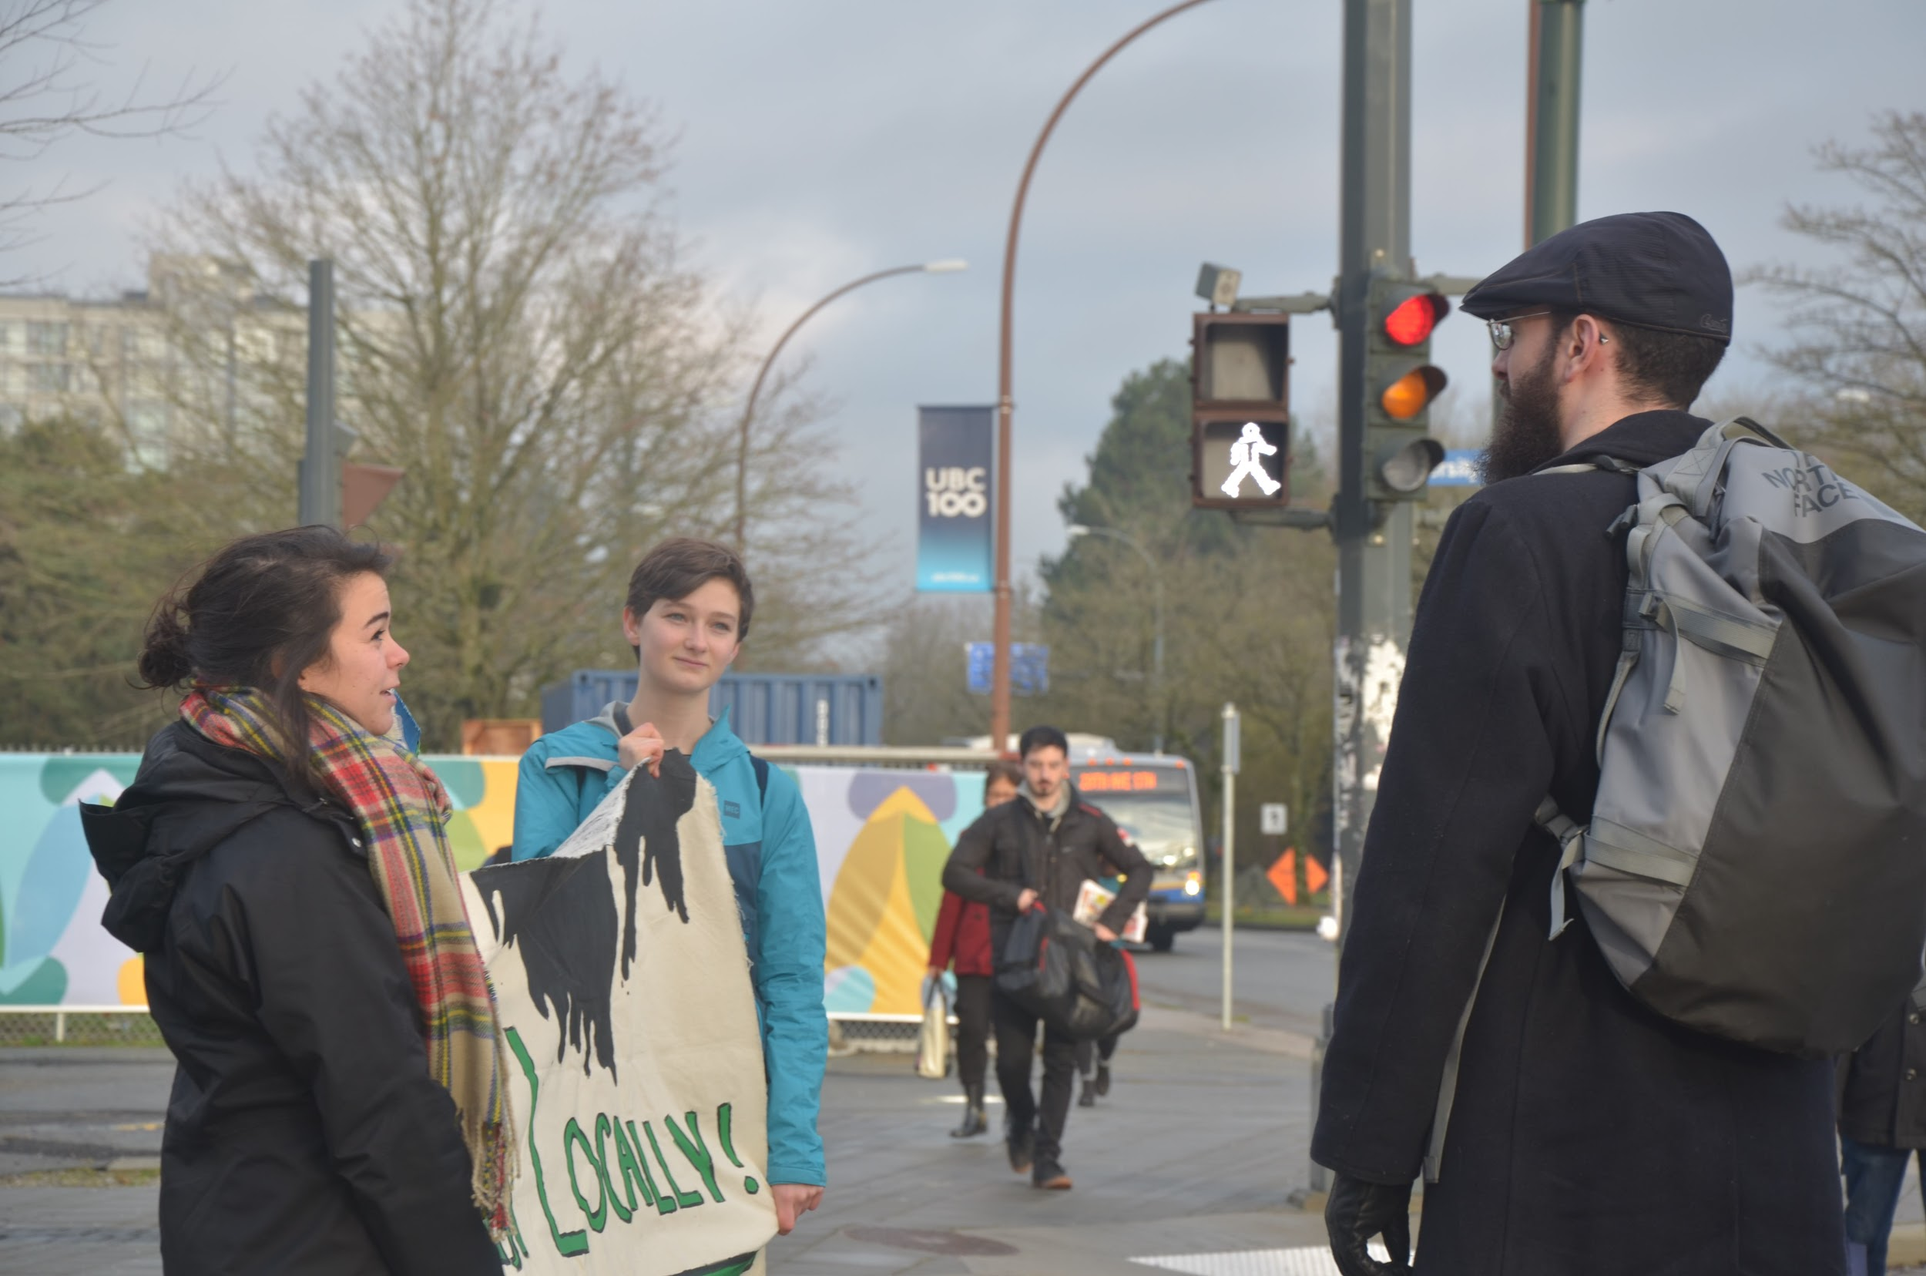
Building support
Notes:
Arianna
Face to face conversations!

Slide 34

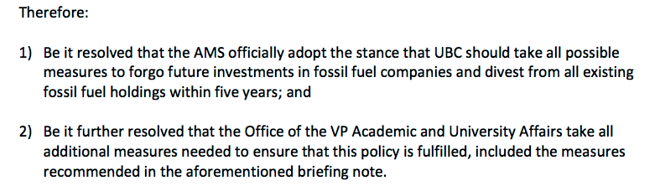
Jan 2014: AMS Student Referendum
77%
of UBC students in support of fossil fuel divestment
AMS Official Policy:
Notes:
Arianna
In 2014, 6786 students (76.9% of voters) voted yes to divestment in the AMS referendum, making it an official policy of the UBC Alma Mater Society. This referendum was put on the ballot after UBCC350 collected over 1200 student signatures in support of the Divest UBC initiative.

Slide 35
Apr 2014: Board responds with “Responsible Investment” Policy
Divestment will only be considered if two constituency groups vote to support it
Opting for false solutions
  Incorporating ESG factors
  Shareholder engagement
Criteria for consideration of divestment:
Proven social, political, economic, and environmental rationale
Reasonable evidence that divestment is effective
Absence of alternative policies
Consistency with the University’s legal obligations
Consistency with the University’s other relationships
Emphasis on “fiduciary duty”
Notes:
Arianna
https://treasury.ubc.ca/files/2014/04/ubc-endowment-responsible-investment-policy-apr2014.pdf
Not only did UBC refuse to consider the expressed will for divestment at that point, the Board passed a new policy in April 2014, which retroactively required that another constituency - such as faculty - hold a referendum, before the issue would be considered.
Retroactive imposition of policy regarding divestment: The student referendum in favour of divestment was passed in February 2014. Not only did UBC refuse to consider the request for divestment at that point, but the Board passed a new policy in April 2014, which retroactively required that another constituency – such as faculty – hold a referendum, before the issue would be considered.
Explain issues with these criteria

Slide 36
Strategy 2:
Make the Case
Build People Power
Demonstrate Public Support
Notes:
Arianna

Slide 37
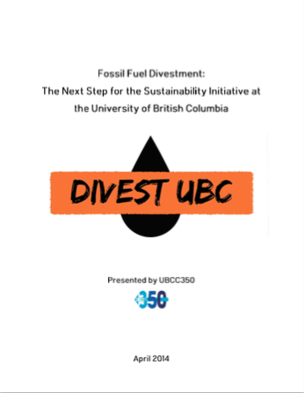
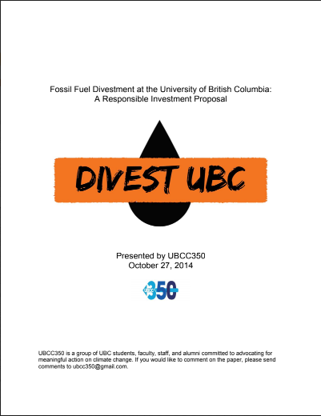
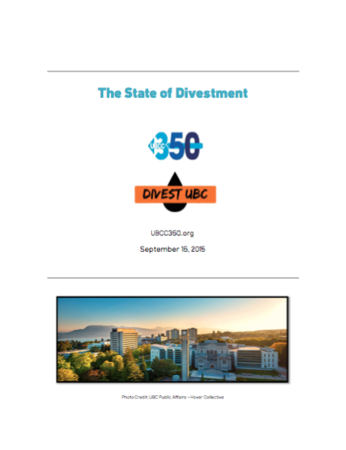
Making the Case: Proposals to the Board
Appealing to the moral argument, climate science, carbon budget & stranded assets, and UBC’s leadership in sustainability.
Notes:
Arianna
Making the case for divestment

Slide 38

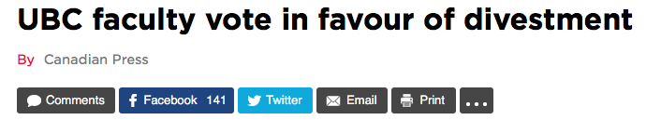
Feb 2015: UBC Faculty Referendum
62%
of UBC faculty in support of fossil fuel divestment
Open letter from faculty calling for divestment, signed by 228 members
“We believe that we have a moral duty to address the climate crisis. Inadvertently supporting such a destructive industry is inconsistent with UBC’s core values of sustainability, leadership, and innovation. It is wrong for UBC to continue to profit from its investments in fossil fuel companies that contribute so directly to dangerous climate change.”
Notes:
Arianna
62% of faculty voted in favour of the referendum, and they wrote an open letter calling on UBC to stay accountable to its supposed core values of leadership and sustainability by divesting.
In 2015, after the Board passed a policy requiring that another group on campus hold a referendum in order for divestment to be considered (in an attempt to slow down the divestment campaign), UBCC350 launched into organizing for faculty support of divestment. This resulted in 228 faculty members to signing an open letter stating that: “We support the overwhelming call by students for divestment. The time has come for UBC to take the next step, and live up to its ideals.” Furthermore, of the 955 faculty who voted, 62 per cent voted in favour of divestment from fossil fuels in a clear majority. A proposal for full divestment was then submitted to the Finance committee with these mandates from staff and students...

Slide 39
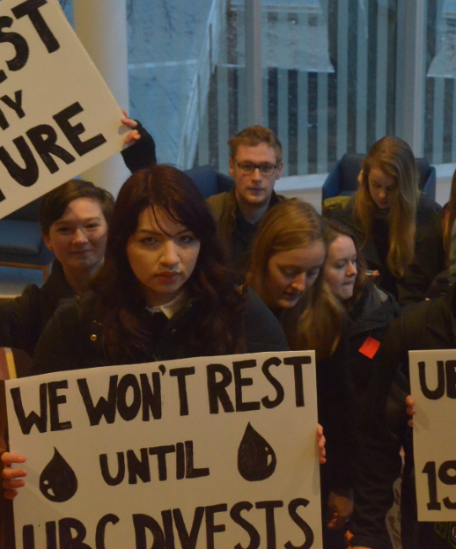
Feb 2016: The Board Votes No
Notes:
Arianna
The Board voted no (recommendation from the finance committee), save for the student representatives who voted in favour. C350 students witnessed this meeting with signs and speeches, delivering letters to each governor and vocalizing “you’re failing us”.
Open letter by Alex & Alastair: https://drive.google.com/file/d/0B-PgFAf8AAXGUkktY2NUdFhvdEU/view?usp=sharing
Alex made a speech (rare)
“You’re failing us” + putting letters on their desks
Julie says there hasn’t been a fair consideration
Student reps voted against the divestment rejection, contrary to the rest of the Board

Slide 40
Why did the Board vote not to divest?
Fundamental opposition
Conservative mindset regarding investing
Not wanting to upset donors or other external influences
  Divestment is “too political”
  FOI showed evidence of communication with Canadian Association of Petroleum Producers
Lack of accountability to the community
Rigged process
Illogical and ill-intentioned criteria
Refusal to consider evidence in support of divestment
  Refusal to meet with us
  Ignored any evidence beyond our brief
  No community consultation
  No consultation with experts
Flawed arguments and misinformation
Notes:
Arianna
Fundamental opposition to the idea of divesting
1) Especially among administration. Prioritizing returns, diversification. Idea that investments shouldn’t involved social or political issues.
2) A freedom of information request later showed that the Board had been in communication with the Canadian Assoc of Petroleum Producers - the board had made no effort to honour the requests of students but they were clearly influenced by the CAPP who were unsurprisingly not in favour of divestment
4) Board is not democratic. Mostly appointed - at this point the BC Liberals were in power so their appointees to the board tended to be conservatively minded.
They rigged the process to make sure they wouldn’t come to yes as an answer
Koskie Minsky brief: https://vpfinance.ubc.ca/files/2016/07/Memo-to-UBC-re-Divestment-Proposal.pdf
Seeking out evidence only against divestment. No serious consideration of divestment: The committee commissioned a report from Koskie-Minksy evaluating whether the divestment proposal met their retroactive criteria, but limited the analysis to a bizarrely narrow scope. Specifically, the report excluded consideration of any evidence in favour of divestment except for that contained in a single document: a brief that we, UBCC350, wrote to motivate the case for divestment.
Committee consistently refused to meet with UBCC350: Despite considering a single UBCC350 brief as the only possible source of evidence in favour of divestment, the committee refused to meet with us at any point in its decision-making process.
The committee’s refusal to meet was despite our repeated requests (including on 21 May 2015; 3 June 2015; 16 June 2015; 22 June 2015; 25 September 2015; documentation available). To reiterate, our requests did not simply go unanswered, but rather were explicitly refused (also documented).
No community consultation: The broader UBC community did not receive the opportunity to engage with the committee on divestment. In stark contrast, the University of Toronto’s advisory committee on divestment held consultations with a wide range of community members and stakeholders. FOI showed they were just waiting for us to graduate. Didn’t care about what students/faculty thought.
Narrow composition of committee: UBC has a wealth of academic experts who could be drawn upon to address the complex issues of divestment and climate change. This institutional wealth of expertise was actively utilized in the University of Toronto’s committee process, but not in UBC’s process.
No public documentation of the committee's meetings: As far as we know, there is currently no public record or minutes documenting how the Responsible Investment Policy Committee came to its recommendation or what information was considered.
3) Misinformation - Board was not well researched; just accepted the Koskie Minsky report as fact. Very misinformed about divestment because they were ignoring the evidence.
The process the Board used to come to this initial decision was heavily flawed. First, they cited a set of five divestment criteria that had only been made after the AMS’ proposal, meaning there was no chance for a fair proposal to be formulated that addressed these criteria. Additionally, no evidence outside of the document that the AMS wrote was considered, meaning that the board did not do any extra research beyond the limited information presented by the student-made proposal. The Board then rejected any requests to meet, and chose not to conduct any form of community consultation. Interestingly, while they didn’t have time to meet with students, they did have time to consult with the Canadian Association of Petroleum Producers, who unsurprisingly were not supportive of the divestment proposal.

Slide 41
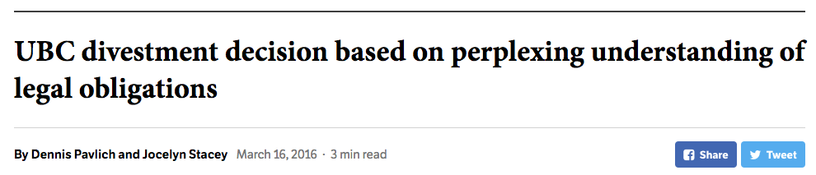
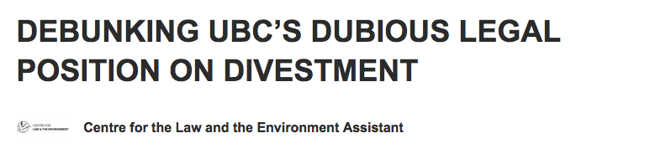
A misunderstanding of fiduciary duty
By Stepan Wood, Canada Research Chair in Law, Society and Sustainability & Director of the Centre for Law and the Environment - Nov 1, 2019
Notes:
Arianna
The rejection of divestment relied heavily on a misunderstanding of fiduciary duty. UBC said that they had a fiduciary duty to their donors. In reality though, donors have no control of their investments. The investments have to be invested in the best interest of the purpose of the investment, which is to advance UBC’s academic mission by providing scholarships and research opportunities.
UBC’s own law profs spoke out about this - first in 2016 after the inital vote, and again in 2019 as you’ll hear later. The slide shows articles published explaining UBC’s erroneous understanding, including one by Dennis Pavlich, a former UBC University Counsel and former Vice President External and Legal Affairs

Slide 42
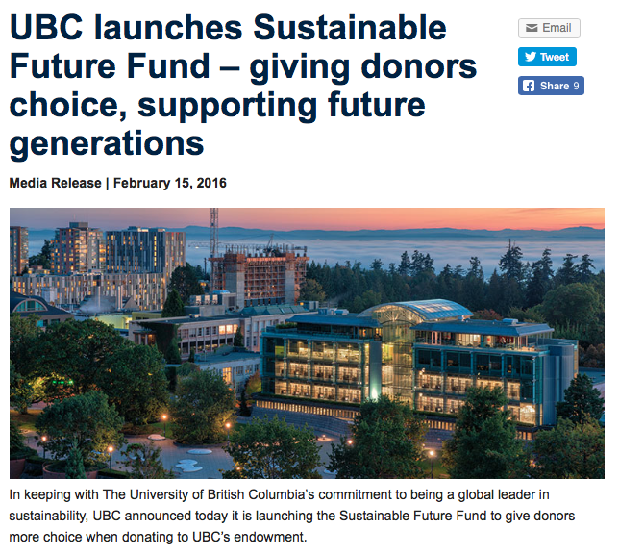
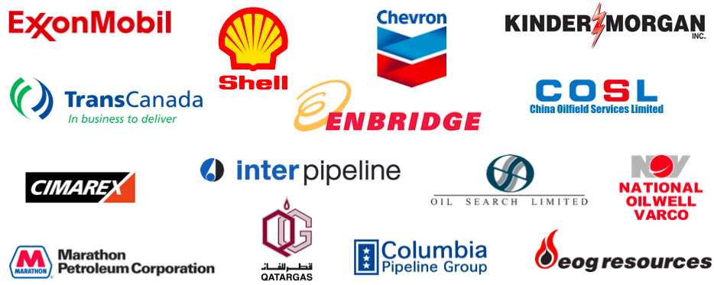
Feb 2016: “Sustainable” Future Pool
$10 million “low carbon” fund
Less than 1% of the endowment
What the Board called “low carbon”:
Notes:
Arianna

Slide 43
Discussion Time - 5 mins
Notes:
Chloe

Slide 44
Strategy 3:
Prove divestment is possible
Notes:
Michelle
While the rejection by the Board was a hard blow for the campaign, it didn’t in any way lessen our resolve.
I know that personally, I joined the campaign right around the time that the Board made that decision - that was the first Board meeting I attended. I was so frustrated seeing how the Board just totally ignored the sound arguments made by the students of UBCC350, who were my new role models at the time. It didn’t make sense to me why an acclaimed leader in sustainability would vote down divestment. I was determined to find out why and reverse that decision.
As a group, recognizing the board wasn’t receptive, we pivoted from advocating for full divestment, and started chipping away at small wins. The goal was to prove that divestment is possible. During this time we also devoted some more energy to other campaigns such as electoral organizing and protesting the trans mountain pipeline so we could continue to grow the movement while the case for divestment grew stronger.

Slide 45
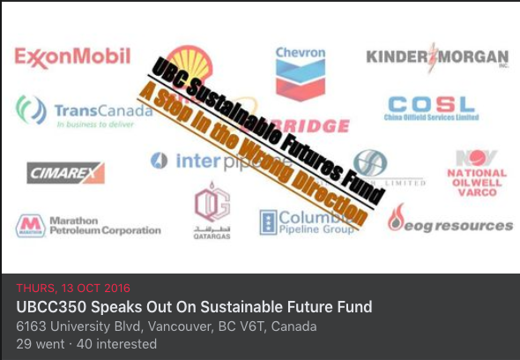
Oct 2016: Sustainable Future Pool Campaign
Notes:
Michelle
The first step was to make sure the sustainable future fund was actually, you know, sustainable. While it was small amount of money, we knew if we could make sure it was fossil free, it could act as a starting point for full divestment.
In advance of the meeting where they were going to discuss the fund, we rallied the community to send 150 emails to the Board calling on them to make the fund fossil free. We showed up with signs, and one of our organizers, Steph, gave a presentation. Then the Board surprised us with 3 consultants they had flown in from Toronto and San Francisco to defend the fund. One of our organizers Alastair, was given the opportunity to ask questions. He asked how a low carbon fund could include fossil fuel companies, citing his research on the specific fund. The consultants were clearly caught off-guard, having no answers to give. It was an amazing scene to witness. I think that moment won a lot of respect from the Board.
We felt pretty good about that meeting but weren’t sure it if it was enough. A few months later we went back to the Board.

Slide 46
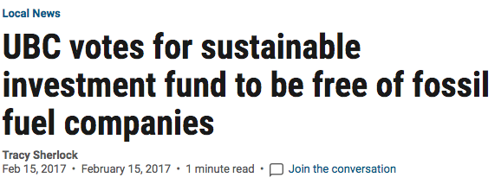

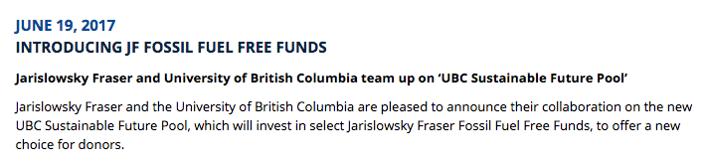
Feb 2017: Sustainable Future Pool Becomes Fossil Free!
Notes:
Michelle
There was a proposal on the agenda to make the sustainable future pool fossil free. It passed unanimously. UBC agreed to start with $10 million and grow the fund over time through additional contributions as well as opening it up to donors. This was significant because it prompted an investment firm to create its first fossil free fund and it resulted in the largest fossil free pool at a Canadian university. Though of course, lots of more work to do.

Slide 47
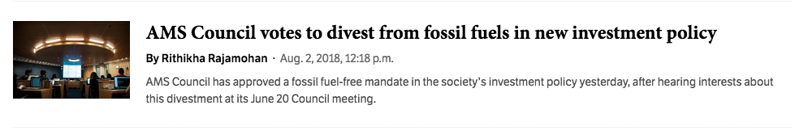
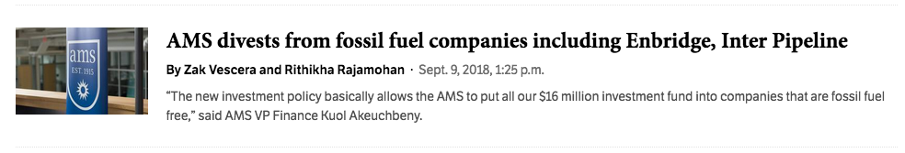

Aug 2018: AMS Divests
Notes:
Michelle
The other campus fund we thought we could leverage was the AMS endowment fund of $16 million. The AMS had a formal policy to support divestment so we believed they had a duty to divest their own funds. I actually applied to work for the AMS that year as the AVP Sustainability and in that role my first priority was divestment. When I got access to the AMS’s investment list I found a fossil fuel company within the first 5 lines. I worked with the AMS VP Finance to put forward a motion for divestment, citing the AMS’s previous stances. The motion was supported unanimously. But it would not have been possible without the student referendum that UBCC350 had organized 4 years earlier.
From there, divestment became an increasingly hot topic for the AMS. During 2018-2019 school year, our group started doing more divestment education including canvassing, teach in’s and a Break Up with Big Oil campaign. With increasing student awareness of the issue, AMS candidates knew they had to make their support for divestment clear in order to win. As a result, we had a slew of new allies on our side.

Slide 48
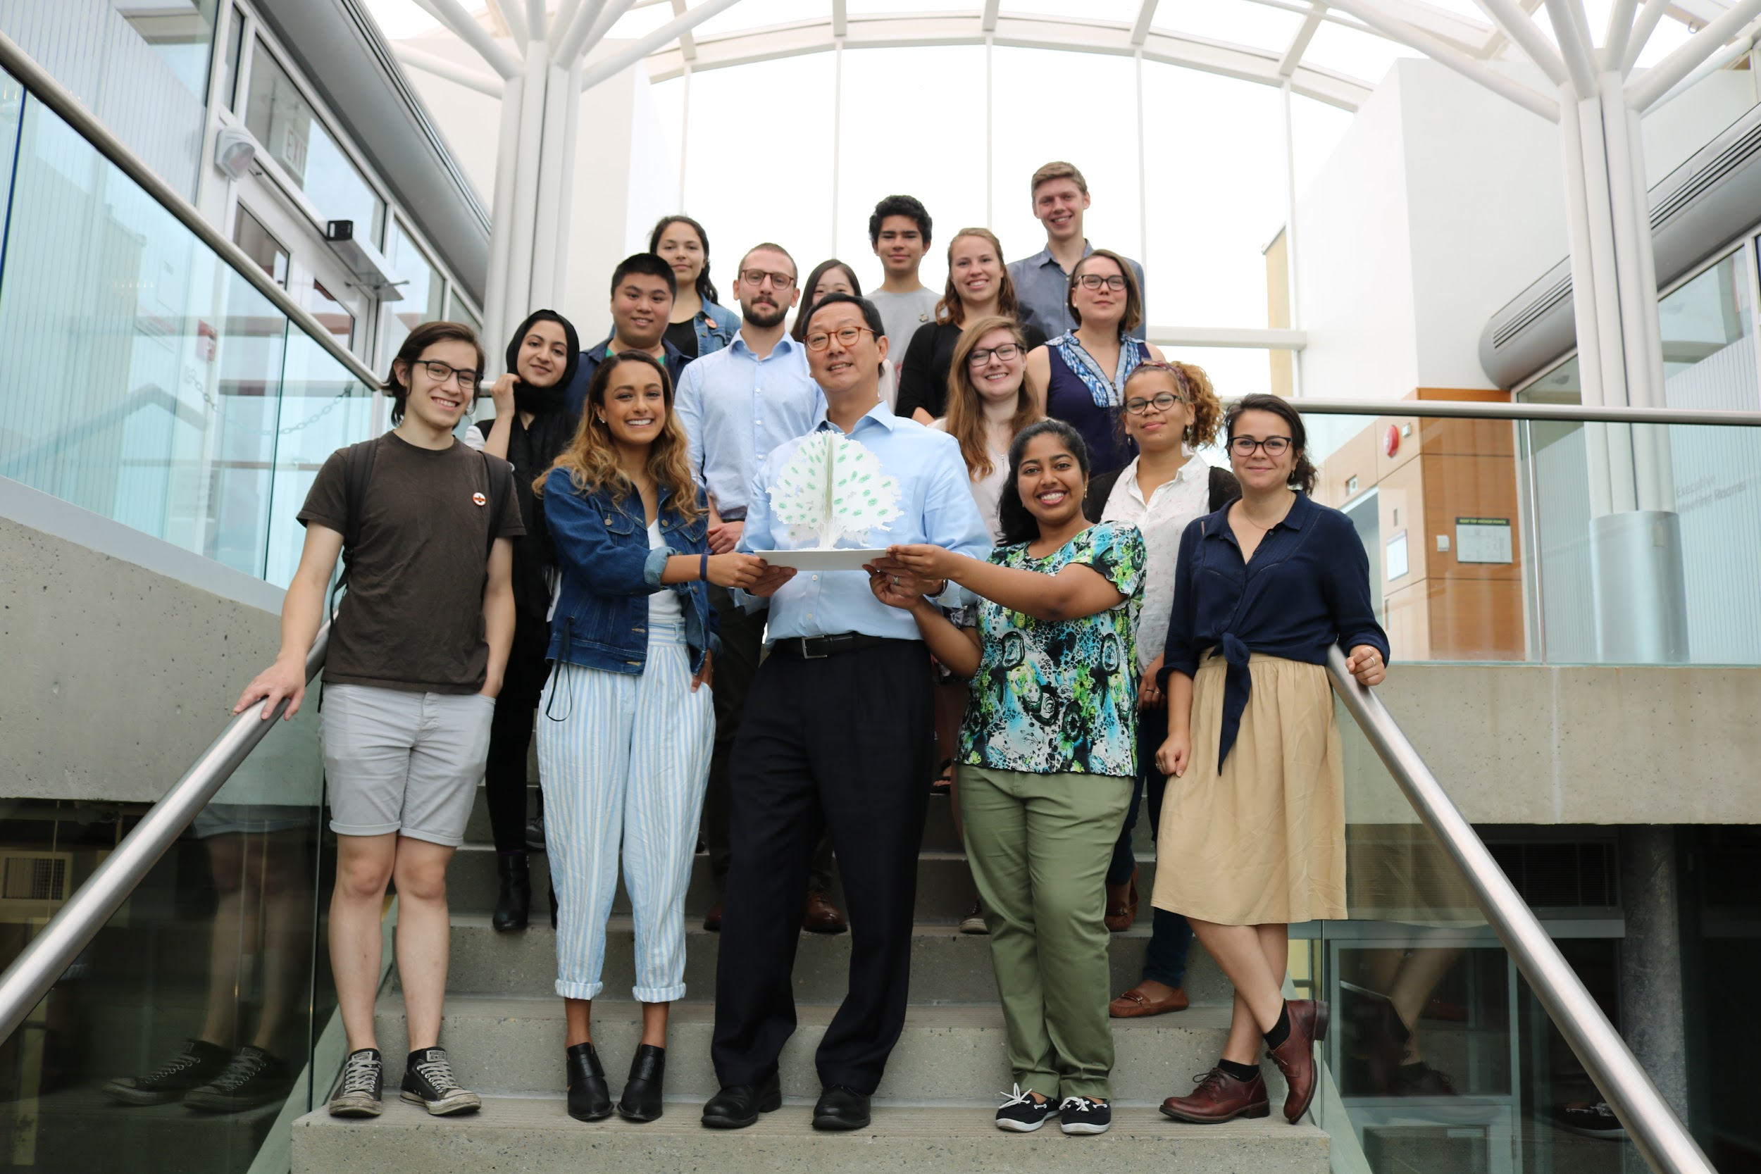
Lots of talk, little action
Climate friendly rhetoric
  Meetings with President Ono
  Strategic Plan commitments
  2018: UBC founding member of the University Climate Coalition
  2019: UBC ranked #1 university in the world for climate action
April 2019: Board commits to add $10 million to SFP per year for the next three years
  At this rate, divestment in ~150 years
Notes:
Michelle
With these wins under our belt, we felt it was time to bring the issue directly to the university again. President Santa Ono had joined UBC in 2016, and during that time had expressed support for divestment and a commitment to climate action both publicly and in private meetings with our team. But three years had passed and little progress had been made. In April 2019, the Board agreed to add $10 million to the Sustainable Future Pool every year for the next three years, but at this rate full divestment wouldn’t be achieved for 150 years.
That same month, UBC was ranked #1 university in the world for climate action. We couldn’t let UBC continue to get away with this greenwashing.

Slide 49
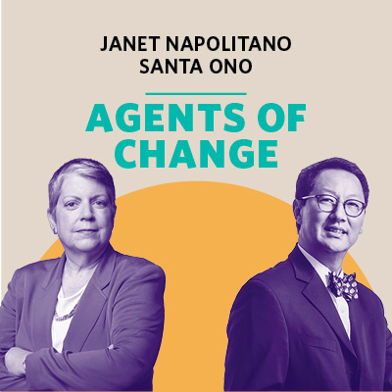
“Universities’ convening power, their deep community ties, their subject-matter expertise, and the energy of their students, faculty and staff make them an invaluable resource to urgently solve the world’s most intractable problems. With their emphasis on cutting-edge research and innovation in the interest of the public good, the University of California and the University of British Columbia are well-positioned to lead the way towards a future that is sustainable and thriving for all.”
Notes:
Michelle
Then we saw that UBC was hosting an event called Agents of Change alongside the president of the University of California, as part of UBC’s membership in the University Climate Change Coalition. The event would be about the role of universities like UBC and UC in “leading the way towards a future that is sustainable and thriving for all.”

Slide 50
Strategy 4:
Force the University to pick a side
Notes:
Michelle
It was time to step up the pressure and this seemed like the perfect opportunity. We needed to bring UBC’s hypocrisy to light. We would no longer let the university say one thing while doing another. UBC had to pick a side.

Slide 51
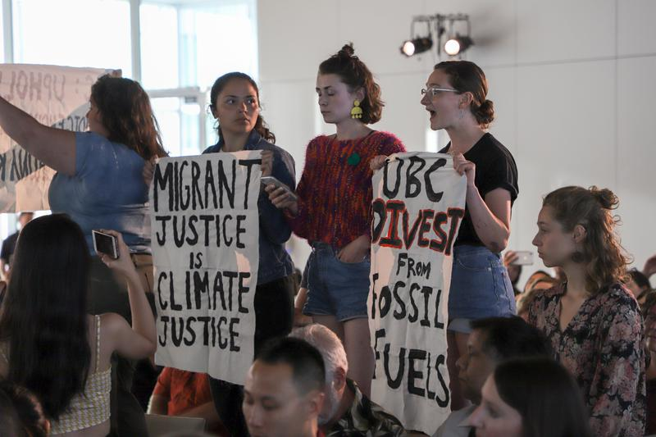
July 2019: Agents of Change Action
Notes:
Michelle
Before the talk, we gathered outside the alumni centre, for a rally and banner drop. After the talk, three students, Kate, Gabby and Carissa, stood up, calling out UBC and UC for their investments in fossil fuels and support for the Thirty Metre Telescope which violates Indigenous rights in Mauna Kea, as well as Janet Napolitano’s role in deporting 1.5 million migrants during her time in the Obama administration, all actions contrary to the principles of climate justice.
We didn’t know what to expect going into it. I didn’t even speak and my heart was racing, palms sweating, the whole talk, waiting in anticipation for the moment when we would stand up. So you cannot imagine our relief at the warm response we received from the audience - in fact, I’m pretty sure we got a bigger applause than Santa and Janet themselves. Alumni, faculty, staff, students and community members came up to thank us for speaking out. It was clear that the community was on our side.
As for the response from the President, in his usual style he emphasized that divestment was not his decision, deflecting responsibility to the board of governors. But he committed to discussing divestment with the rest of the Board of governors, which was a positive sign.
https://www.youtube.com/watch?v=v82BTn7hNdA
----------------
https://www.ubyssey.ca/news/students-demand-divestment-at-climate-crisis-event/
The university is hosting an “agents of change” lecture and Q&A with UBC president Santa Ono and the University of California president, Janet Napolitano. According to the events page (https://sustain.ubc.ca/events/agents-change?fbclid=IwAR0T-3Qk638Ta9wn-bpXC1GHIjz-y_xCktNx-gBN5fysQh-WoGxugcHc4A0), these universities are “well-positioned to lead the way towards a future that is sustainable and thriving for all.”
But how about UBC’s $85 million invested in fossil fuels? UBCC350 have been campaigning for full divestment for years; but so far, only a $15 million “Sustainable Future Pool” has been created, which makes up only 1% of UBC's total investments.
See more details here: https://www.ubyssey.ca/news/ubcc350-calls-on-ubc-to-divest/
We will be outside the building where this event is taking place, spelling out the word “divest” with our bodies on the ground. This will be captured on video and will call out UBC’s hypocrisy in claiming to be leading the way to a sustainable future. We are in a climate crisis - UBC’s non-commitment to fully sustainable investments will not be nearly enough to provide for their students’ futures.
Please arrive promptly at 5:15pm with banners and signage: “divest the rest”, “UBC divest”, “fossil-free UBC”, and anything else which you can create!

Slide 52
Sep 2019: UBC reaffirms opposition to divestment
Proposed Endowment Responsible Investment Approach:
“UBC does not believe that divestment is an effective strategy for addressing long-term and persistent ESG risks. Ownership gives UBC the right to raise concerns and influence a company on matters relating to corporate governance, as well as its environmental and social practices; [...] engagement is our preference.”
“Divestment:
Eliminates our rights as a shareholder to engage with management and raise awareness of long-term risks and encourage change of practices.
Does not encourage companies to amend their policies and practices.
May compromise our investment strategy, increase risks and costs, and negatively affect our investment returns.”
Notes:
Michelle
He seemed to forget about that promise though because two months later, the administration put forward a new “responsible investment” proposal, which asserted that “UBC does not believe divestment is an effective strategy,” that divestment is not consistent with UBC’s fiduciary duty and that divestment would have a negative financial impact. We felt betrayed. Six years of campaigning, plus three years of false promises and UBC still hadn’t put an ounce of consideration into divestment. It was clear from the presentation that the administration misunderstood the theory of change behind divestment and hadn’t looked at any of the evidence in support of it.
We attended the Board meeting, made our frustration known and were pleased to see the Board finally sympathizing with our concern. The Board chair remarking that it was “relatively uninspiring with a strong odour of the status quo”. They turned down the proposal, calling for a more ambitious plan.

Slide 53
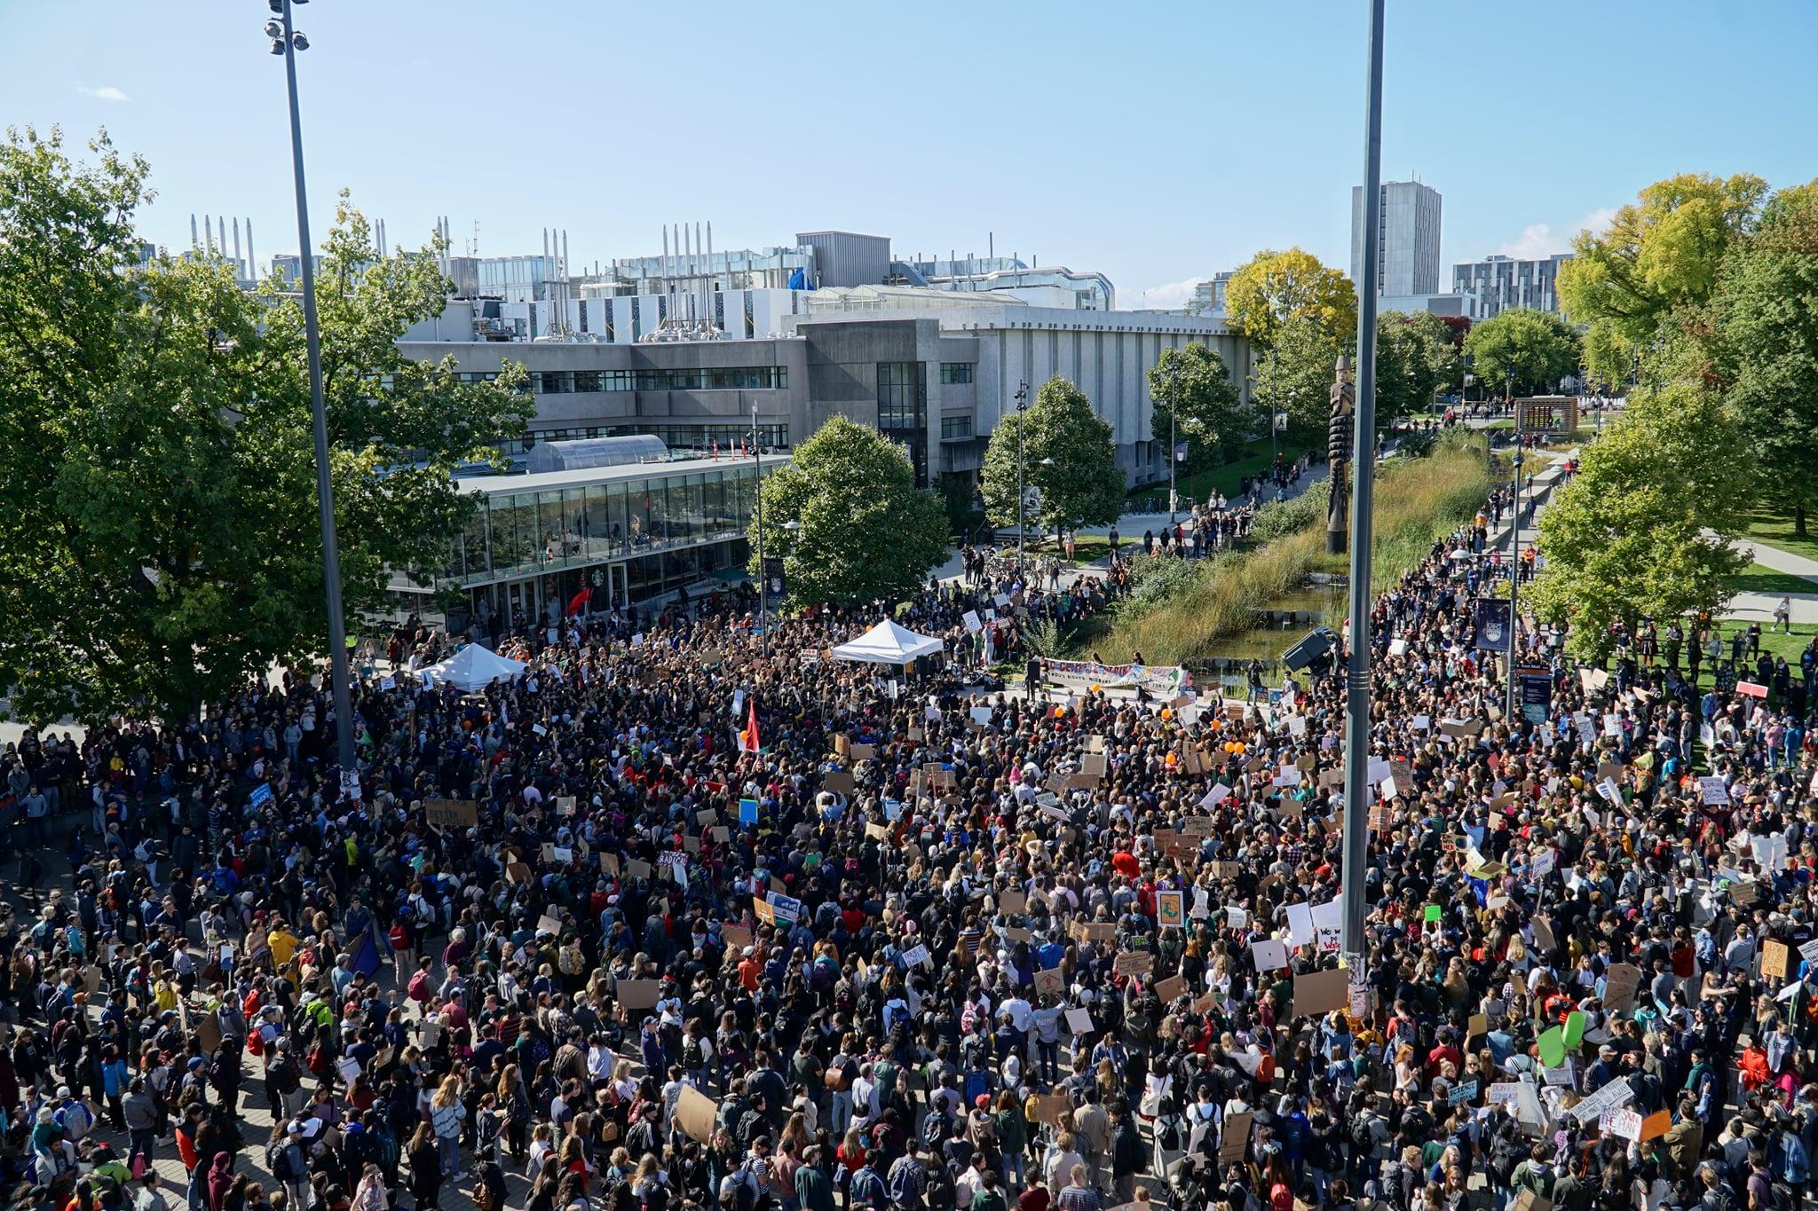

Sep 2019: UBC Climate Strike
Notes:
Anna
One week after the Board meeting
On September 27 2019, 5,000 students, faculty & staff walked out of their classrooms and offices for the UBC Climate Strike, calling on UBC to declare a climate emergency.
Leveraging a much bigger global moment
Key turning point! Everyone was talking about divestment and climate change. Awareness and engagement levels so much higher than before. Never had seen anything close to this much involvement. The university could not ignore the public pressure anymore.
30+ departments/faculties made statements in support

Slide 54
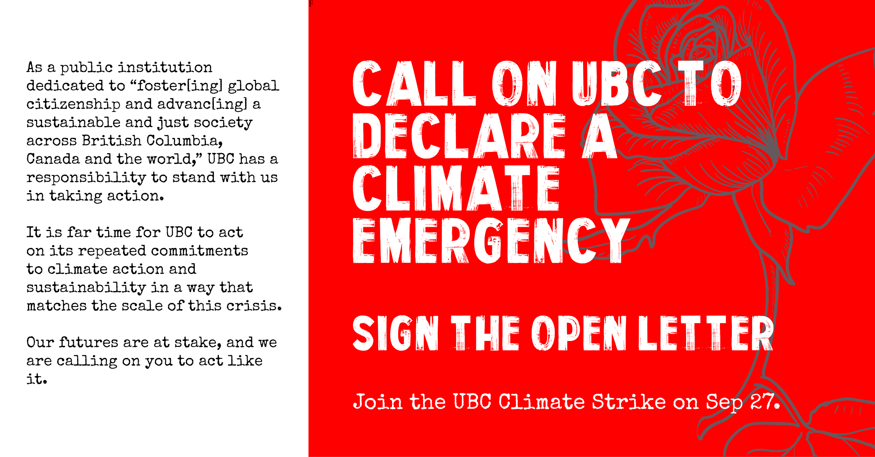
Notes:
Anna
Over 1,500 students, staff, faculty and 70+ campus organizations signed on to our open letter calling for UBC to declare a climate emergency, re-evaluate fossil fuel divestment, account for scope 3 emissions on campus, and expand support for climate research and education.

Slide 55
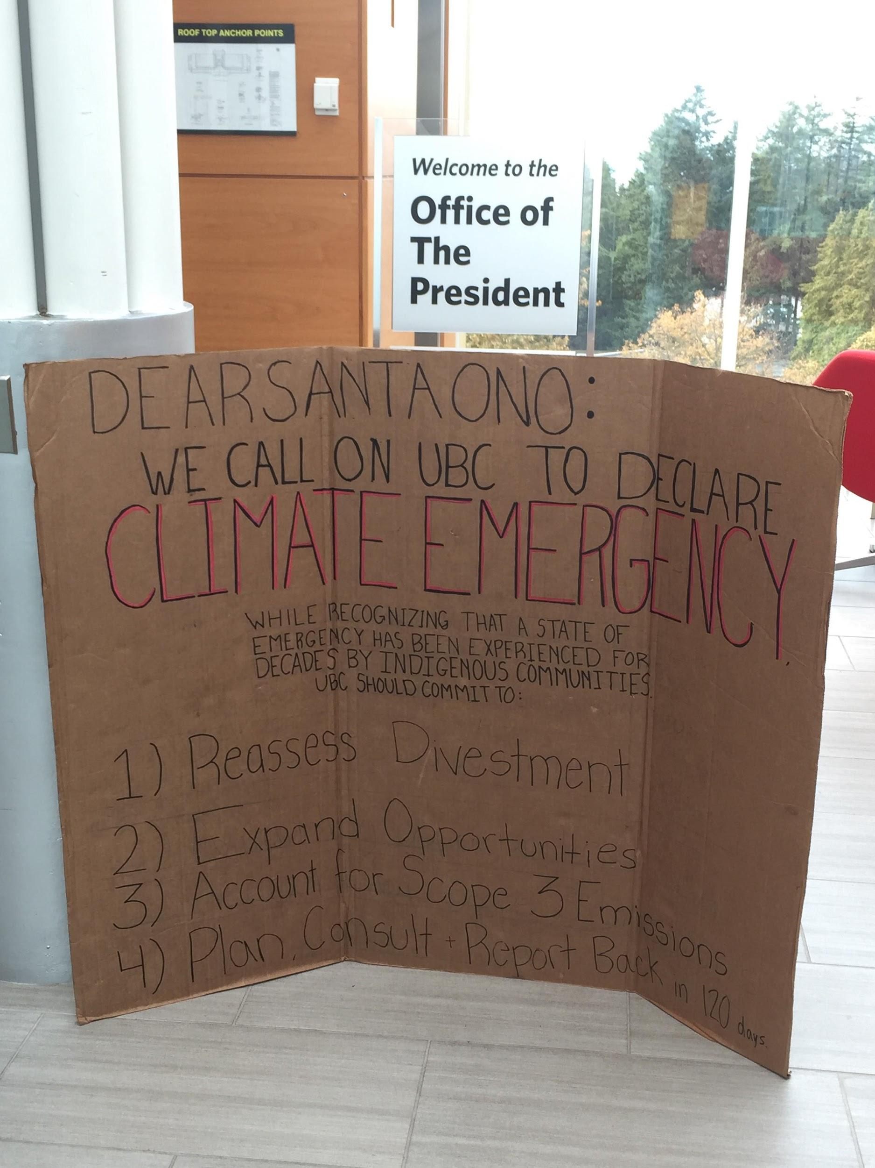
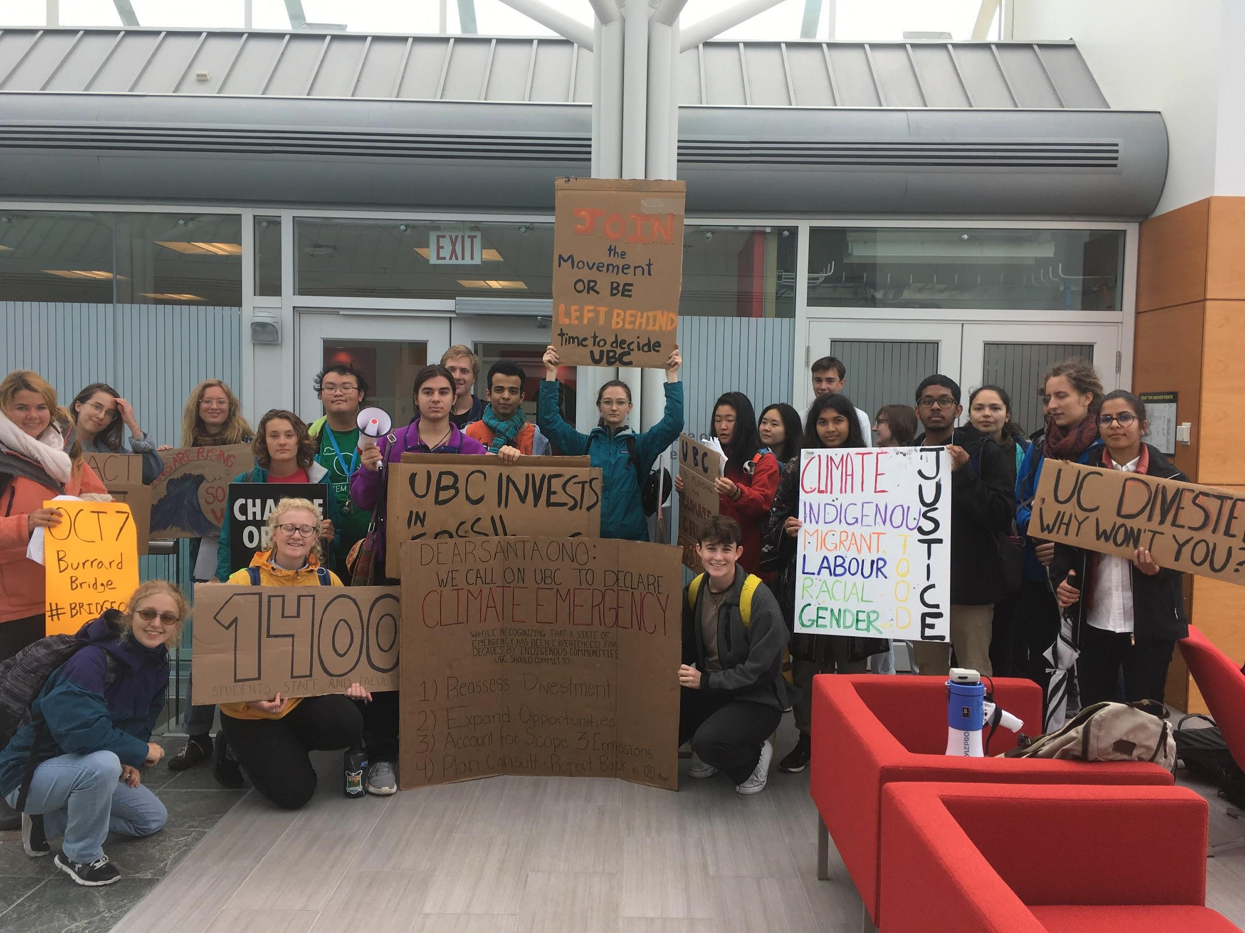
Oct 2019: Open Letter Delivery
Notes:
Anna
One week after the strike - We delivered our open letter to Santa Ono’s office together, holding UBC to account on its commitment to climate leadership and to the needs of the UBC community.
Santa responded with interest in meeting and increasing UBC’s climate commitments → worked with him on climate emergency declaration and divestment conversation

Slide 56
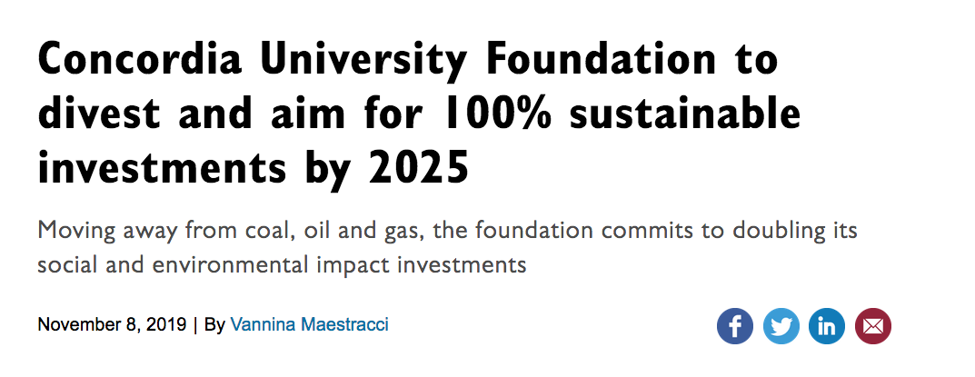
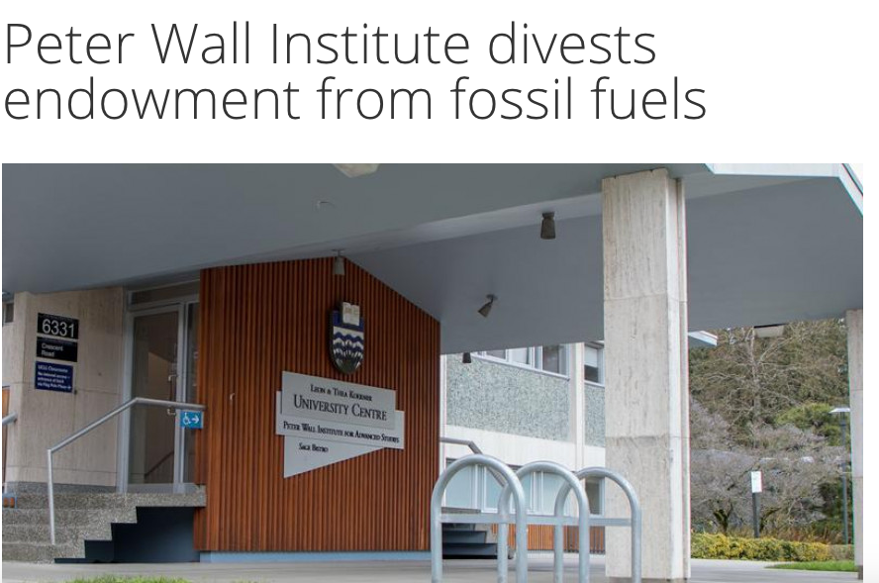

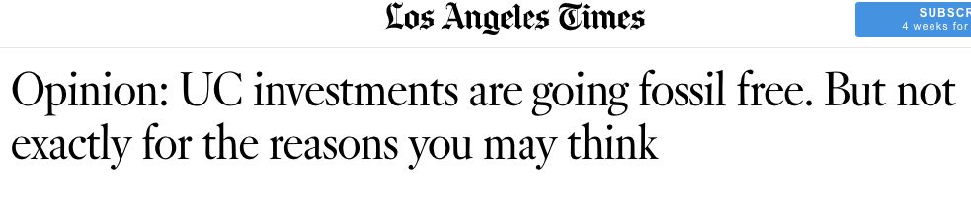
Sep/Oct 2019: External Pressure Ramps Up
Notes:
Anna
Concordia: first major university in Canada to commit to divestment!
UC - $13.4 billion endowment + $70 billion pension. Significant because UC co-hosted the Agents of Change event and founded the university climate coalition
Threatened UBC’s #1 ranking on climate

Slide 57


Nov 22: Responsible Investment Committee Meeting
Notes:
Anna
After meetings with Santa, the treasurer and legal counsel, and with support from student board reps, the administration put forward a proposal to the responsible investment committee meeting for partial divestment ($381 million or about 25%, divesting the land revenue put not donor revenue)
We packed the boardroom and hallways with hundreds of students, chanting in support of divestment and waving signs. We saw partial divestment as a good step but it was coming far too late. We told the board that we cannot accept anything less than full divestment.
Explain the photo on the left - The goal of the action was to force board members to pick a side. They can no longer can claim to support climate action without divesting
Event page:
We are in a climate crisis, and UBC can’t claim to be a climate leader while actively profiting from the industry that is compromising our futures, violating Indigenous rights, and fueling injustice in our communities.
This Friday, the ERIP Committee of the Board of Governors will meet to decide whether or not to champion fossil fuel divestment at UBC. We’ll be there to remind them—loud and clear—that UBC students won’t accept anything less than full divestment.
To change everything, we need everyone. Join us this Friday as we call on UBC to divest, now! Bring your voices, your signs, and your energy.

Slide 58


Nov 22: Responsible Investment Committee Meeting
Notes:
Anna
We presented the case for full divestment.
The action worked! The Board couldn’t afford to let down hundreds of students watching them, counting on them to finally listen. In response, the Board passed the motion for partial divestment and a number of Board members spoke up in support of full divestment, critiquing the proposal for partial divestment as too little, too late. This was a huge shift in perspective, especially compared to the September meeting (just two months prior) when the University Administration claimed that divestment was not effective - we had never seen anything close to the resolute support for divestment expressed on that day!
The next week, a motion to explore full divestment was then forwarded to the Finance Committee which passed it and forwarded it to the full Board. Then we awaited the big day...
Presentation: https://thetalon.ca/pushing-for-full-divestment-ubcc350s-presentation-to-the-board-of-governors/

Slide 59



December 5, 2020: UBC Commits to Divest!
UBC Divests!
Notes:
Anna
On December 5, 2019, the UBC Board of Governors unanimously passed a resolution declaring its support for full divestment of fossil fuels and directing the Administration to conduct a legal and financial analysis toward this end. This was a huge moment!
In an unexpected move, the Board also agreed to remove the condition from the original motion which stated that divestment would only occur if it is shown not to hurt the financial performance of the endowment. This change was driven by governors who emphasized the necessity of strong action in response to the climate crisis regardless of financial implications.
As we were planning every action, it was important for us to know what our public narrative was. When UC chose to divest, they announced that they were divesting for financial reasons. We wanted to build a narrative that would send a clear message - that the fossil fuel industry has no place in higher education and in a climate safe world, not just because of increasing financial and economic risks, but because we are in a climate crisis, and UBC cannot claim to be a climate leader while actively profiting from the industry that is compromising our futures, violating Indigenous rights, and fueling injustice in our communities. We know that the value of this campaign is not in the financial transfers but its role in influencing societal discourse and shifting the political climate.
→ This is why it was so powerful that UBC tied the divestment commitment to a declaration of climate emergency!
-----------------
In committing to explore full divestment, UBC is finally breaking its ties with the fossil fuel industry and paving the way to other organizations to follow. This is a public denunciation of the fossil fuel industry and its role in fueling the climate crisis and stalling action for decades.
We cannot express enough gratitude to all our organizers over the past 6 years and everyone who has been part of the movement. From the folks who started this campaign back in 2013 to those who've been pushing to the finish line to everyone who showed up along the way - whether it was coming to an action or emailing the Board of Governors or making a banner - this wouldn't have been possible without you! We are so so proud of what we've accomplished, together. This is a testament to the power everyday people have when we organize and fight for justice. WE DID THIS! 🎉🎉🎉
Now let's spread the word so that no politician can ignore what our academic institutions now understand: there is no place for fossil fuels in a climate-safe world. We are rising, and the era of the fossil fuel industry is coming to an end.
https://drive.google.com/file/d/1tDhz2-1t8dHCqt8yRRdVGhzyPETxNv-7/view?fbclid=IwAR0_wZwc7E_akNbRA2l4p4xGnulnZSWPoCbnMVlFjKd55aNgwz_7YuiW2Ug

Slide 60


December 5: And Declares a Climate Emergency
Dec 5
Notes:
Anna
https://president3.sites.olt.ubc.ca/files/2019/12/Climate-Emergency-Declaration.pdf
President Santa Ono declared a climate emergency which recognized the need for a “decisive shift away from fossil fuels” and “a rapid and just transition to a sustainable economy” in line with the United Nations Declaration on the Rights of Indigenous Peoples. The declaration tied the divestment decision to the injustices propagated by the fossil fuel industry. The declaration was the result of our open letter and subsequent meetings with the president. It was endorsed unanimously by the Board.
The declaration formally acknowledges the severity of the climate crisis - including its disproportionate impact on marginalized communities - and the scale and urgency of action required through major transformations across all economic sectors. In line with the Climate Emergency Declaration, President Ono committed to launching a community engagement process and the Board of Governors formally created a Climate Action Committee, which includes the UBC Climate Hub and other stakeholders, setting out the framework by which all the university’s actions are guided.
“On December 5, 2019, the UBC Board of Governors unanimously passed a resolution supporting full divestment of fossil fuels from UBC’s Trek Endowment Fund in a manner that is consistent with the fiduciary obligations of the Board. The Board also unanimously passed a motion approving in principle the full divestment of the remaining balance of the $1.71 billion Main Endowment Fund from the fossil fuel industry.”
On December 5, 2019, the UBC Board of Governors unanimously endorsed President Santa Ono’s Declaration on the Climate Emergency, setting out the framework by which all the university’s actions are guided. Key points in the Declaration are:
That the climate crisis is posing and will continue to pose extensive and disastrous threats to peoples’ lives and livelihoods both locally and globally, contributing to famine, migration, and disease worldwide, including impact on individual physical and mental well-being.
The need for drastic emissions reductions and a decisive shift away from fossil fuels toward alternative energy sources, as laid out by the science of the Intergovernmental Panel on Climate Change (IPCC), the UN Production Gap Report and the Paris Agreement, to be achieved via rapid and far-reaching transformations across all economic sectors.
That Indigenous and marginalized communities bear the harmful impacts of fossil fuel extraction and climate destruction while being least responsible for the global acceleration of the climate crisis.
That the university will consider the full scope of our impact and align UBC’s emissions reduction plans with 1.5˚C; to embrace the need for a managed decline of fossil fuel use and a rapid and just transition to a sustainable economy that also aligns with UNDRIP; to infuse climate justice throughout our activities, priority, and decision-making frameworks; and to support community coping and adaptation in the face of climate crisis.
That UBC’s education, research, and innovation capacity in sustainability is creating breakthrough solution for the most pressing challenges of the climate emergency and transition to a fossil fuel free economy.
UBC joins with other universities and communities in declaring a climate emergency. (Noting that we are actively encouraging all universities to move towards divestment and sustainable investment frameworks in order to combat climate change and create a more sustainable future.)

Slide 61
Discussion Time - 5 mins
Notes:
Chloe

Slide 62

Feb-Apr 2020: Divestment Moves Forward, Clears Legal & Financial Hurdles
February 2020: Legal opinion affirms that UBC can and indeed must divest if financially prudent to do so.
April 2020: Financial analysis confirms that divestment is financially prudent.
Notes:
Michelle
Before UBC’s divestment commitment in 2020, all the legal opinions UBC had solicited said that UBC could not legally divest, as per the misunderstanding of fiduciary duty we explained earlier. So in order to follow through with the commitment, UBC had to get a new legal opinion. The new legal opinion, which was reported on in february 2020, stated that UBC can and indeed must divest if it is financially prudent to do so. With that, UBC commissioned a financial analysis which showed that investments in fossil fuels pose financial risk and thus divestment is financially prudent.
The amazing thing about the 78 page financial analysis is that it used the exact same arguments and even cited the same research we had been putting forward for years. For example, this graph shows the reserves of the top 200 fossil fuel companies account for 6x the emissions they can safely release. The financial argument is that these assets risk becoming “stranded” because if we are to keep the world to a stable temperature, new climate policies will prevent these reserves from being extracted and burned. If UBC remains invested in these companies, it risks losing the value of those investments.
It’s worth noting that in the end, UBC’s divestment decision relied on a financial argument, rather than a moral one. This speaks to the limits of investment-related activism as a strategy when it comes to less profitable demands. More work is needed to articulate the nature of fiduciary duty, beyond just financial concerns.

Slide 63

Sep 2020: Responsible Investing Commitments
Full divestment by 2030
Reducing portfolio carbon footprint by 45% by 2030
Publishing endowment public equity holdings (released Dec 2020)
Active ownership policy by April 2021
Notes:
Michelle
In September, UBC presented a new responsible investment plan for the board. It included a 2030 commitment to complete divestment and reduce the carbon footprint of the portfolio by 45%. It also committed to finally make public the holdings, which was done in December 2020. In addition, it committed to creating an active ownership policy and working with managers to expand integration of environmental, social and governance factors. We are awaiting for further updates on what this entails specifically.
In December UBC also announced it had started transferring funds to fossil free options, with $34 million transferred.

Slide 64

Feb 2021: Climate Emergency Task Force Report
Notes:
Michelle
In February, the task force which had been launched with the climate emergency declaration, published its recommendations based around 9 strategic priorities including research, education, advocacy, wellbeing, Indigenous rights and more. Within the “leadership on climate justice” section was a recommendation to fully divest by 2025 and reinvestment in a just transition.
So that wraps up the story of the campaign, we will move on to reflections now.

Slide 65
Reflections
Notes:
Rachel

Slide 66
How did we win?
Notes:
Rachel
So how did we get here? This shift in position would not have been possible without years of pressure from UBC students and faculty: from the very first divestment organizers who circled faculty offices collecting signatures to every person who marched in the UBC Climate Strike to the students who packed the Board meeting with signs and songs. To the students who refused to give up despite constant rejection, who continued to organize and pick through legal documents and show up for each other with compassion and courage throughout this fight. This has come only after 7 years of pressure from students and generations of organizers who have campaigned and worked tirelessly to build this movement. From holding a campus-wide referendum (twice!), to putting in countless hours of work to research every angle of what divestment could mean for UBC, and engaging in constructive dialogue with the Board of Governors over the years despite facing push-back, this is the product of a dedicated youth movement.

Slide 67
Diversity of tactics
RESEARCH
MEDIA
ACTIONS
ART
LOBBYING
Investment Law
Board Politics
Divestment Financing
In-person and online lobbying
Social media Op-ed
Newspapers
Protests & Rallies
Banner drops
Teach-Ins
Social Media
Email blasts
Art Builds
Compiling and review research papers
Collaborating and meeting with lawyers
Show up to committee sessions
Sending tweets strategically
Setting up one-on-one meetings
Being vocal about our calls-to-action, having clear demands
Preparing talking points
Publicizing UBC’s bad decisions
Being responsive to announcement and decisions
Organizing students in mass numbers
Building momentum
Creating graphics that will capture the public’s attention and communicate ideas
Keeping up with trends
Notes:
Rachel
The incredible thing about the divestment campaign is that there truly are ways to engage at all levels.

Slide 68





Building public support
Referenda
Canvassing/ outreach
Teach in’s and education
Alliances with other groups
Storytelling & art
Notes:
Rachel
Raising awareness

Slide 69



2) “Outside Strategy”
Climate strike
Actions at board meetings
Banner drops
Notes:
Rachel
Applying external pressure to demonstrate public support
Being visible, loud, annoying!
Forcing them to pick a side, forcing them to look at the evidence
Inside/outside game. Both conducting professionalized / well researched meetings w BoG/President and showing up with people power from the outside. Explain how these complement each other: outside pressure forces them to listen to the people on the inside, inside strategy puts forward arguments/people they are more likely to listen to

Slide 70


3) “Inside Strategy”
Alliances with AMS, Board members
Lobbying meetings
Power-mapping
Presenting the evidence
Notes:
Rachel
Speaking their language, lots of research
Finding people’s motivations and connecting it to that - financial argument, reputation
Student and faculty governors in particular were essential allies of the divestment campaign, as they were often far more accessible and gave us an “in” during meetings that were not available to the public. What I’m getting at here is that the campaign required a lot of one-on-one and group meetings to lobby these governors and swing them to our side. This is part of the organizing that you don’t see from the outside, because it happens quietly and behind closed doors, but skillful negotiation in a bureaucratic context is an absolutely essential part of successful changemaking.
As a group, 350 spent several nights investigating the stakeholders involved in a divestment decision, diving into their Twitter and Instagram history to figure out who might ally with us. This is one of our favourite examples to use when we’re making a case for why we need everybody in this movement. Tasks like research and logistics get incredibly understated when telling stories about activism, but these are skills we would be lost without. This resists the traditional view of activism that makes it seem like public speaking and public protests are required parts of the role. So many people behind the scenes are working to support those who end up featured in the headlines.

Slide 71


4) Sustaining momentum
Passing on knowledge
Persistence
Notes:
Rachel
Sustaining momentum throughout the 7 years
Building our reputation as a prominent CJ group on campus
Not graduating lol
The number of people who’ve worked on this campaign — there are many unsung heroes in this, who’ve helped each carry the campaign along at various times and in various ways. A strength in numbers.
A long-term, sustainable campaign. Possibly because UBCC350 worked on multiple climate issues, this gave the group the diversity and sustainability as a community to move past bad news on divestment, or through periods when divestment, for strategic reasons or other priorities, was a bit quiet. At other schools they didn’t know what to work on

Slide 72
5) External factors
New Board and President with new priorities
Influential divestment commitments: University of California, Concordia, Peter Wall Institute
Notes:
Rachel
There were some factors out of our control that gave us an advantage:
2016 - New President: sustainability high priority (really wants to be a global leader on this issue), trying to smooth over bad UBC PR from controversy over previous president’s “resignation”
2017 - New Board: less corporate interests, more transparency (pressure from faculty for increased transparency had led to some reforms in terms of posting meeting times, agendas & locations; letting the public into their meetings, etc. - made it easier to have a presence at meetings). Board was more interested in listening to and speaking with us
Pressure from many directions - not just us but other actors that influenced UBC e.g. University of California
Wanting to maintain ranking on sustainability

Slide 73
What did we achieve?
Notes:
Rachel
The impact of divestment is so much more than the campaign victories, as important as they are
Even though it might feel slow (7 years), those years aren’t wasted. It's not just about one victory. It's about building that mass movement. Divestment one component of a much bigger struggle for climate justice.

Slide 74
Institutional level
Community level
Societal
level
Compelled UBC to take a political stance on the fossil fuel industry and the climate emergency.
Set a precedent for other schools to follow.
Built long-lasting community of climate justice advocates.
Equipped hundreds of young people with lifelong organizing skills.
Created spaces for questioning the status quo and imagining new possibilities.
Contributed to shifting public opinion and stigmatization of the fossil fuel industry.
Demonstrated the power of grassroots movements (especially student movements) to create change.
Notes:
Rachel
Raised awareness to the unchecked power of the fossil fuel industry.
Opening up conversations about our economic system (one that requires our institutions to value profit making over their students and the planet and humanity). Opening up conversations about the corrupting influence of corporations on our democracy
Building community of young people who are committed to this fight for the long haul and are questioning the systems and power structures around us.
Train organizers to develop skills around campaign design, strategy, canvassing, public speaking, volunteer recruitment etc.
Capacity-building and providing opportunities for people to try new skills
Created network of organizers and allies
Training young people who understand strategy, build a movement, hold decision-makers continues - continue to apply these skills to other movements throughout their lives. Building capacity for other movements.

Slide 75
We are part of a broader movement that is...
Notes:
Rachel

Slide 76





Growing across Canada...
VICTORY!
Notes:
Rachel

Slide 77






...and around the world
Notes:
Rachel
These are all since UBC’s announcement

Slide 78
Removing social license from the fossil fuel industry
“Divestment campaigns have succeeded in putting questions of finance and climate change on the public agenda and played a part in changing discourse around the legitimacy, reputation, and viability of the fossil fuel industry.” (RBC Global Asset Management, 2021)
“The most prominent impact has been the discourse shift, a clear cultural impact, which in turn has precipitated mobilisation, political and financial impacts, as the notions of divestment entered different public spheres, attracting supporters and causing demands from investors and new conversations among financiers.” (Bergman, 2018)
Notes:
Michelle
Research (Bergman 2018) shows that: “While the direct impacts of divestment are small, the indirect impacts, in terms of public discourse shift, are significant. Divestment has put questions of finance and climate change on the agenda and played a part in changing discourse around the legitimacy, reputation and viability of the fossil fuel industry. This cultural impact contributed to changes in the finance industry through new demands by shareholders and investors and to changes in political discourse, such as rethinking the notion of ‘fiduciary duty.’ Finally, divestment had significant impact on its participants in terms of empowerment and played a part in the revitalisation of the environmental movement in the UK and elsewhere.”
Significant impact on public opinion
The most prominent impact has been the discourse shift, a clear cultural impact, which in turn has precipitated mobilisation, political and financial impacts, as the notions of divestment entered different public spheres, attracting supporters and causing demands from investors and new conversations among financiers. The challenge to the legitimacy of the fossil fuel industry is more of a political impact as it (potentially) affects power structures and the political agenda. A different political impact is the changing notion of fiduciary duty, culminating in changing government regulations. All of these impact the world of finance, which is engaged in new conversations around shifting investments and stranded assets, as new fossil-free funds are created and regulations shift.
Divestment’s main focus is normative—raising awareness over the urgency of transitioning to a low-carbon economy [6]. It has changed public discourse in the UK and elsewhere, giving the media a new way to cover the climate change story and making it harder for politicians to show wilful blindness towards the issue [30]. In doing so, Divestment disrupted a stalemate in climate change discourse [35], changing discussions in the finance world and affecting some investors’ and shareholders’ attitudes towards fossil fuel companies. Finally, Divestment has stigmatised the fossil fuel industry [10] and challenged its legitimacy, putting it on the defensive [15]. Overall, this paper strongly supports other research [10] in concluding that the indirect impacts of Divestment significantly outweigh its direct impacts and further suggests that Divestment’s impacts are best measured through its indirect effects on culture, politics and finance.
Impacts on participants were evident both in terms of personal empowerment, taking people from being bystanders to being engaged participants and activists, and in terms of reviving the (student) environmental movement. Divestment provides a model in which different actors can participate and where the sum of local actions has a global impact.
Gunningham: At a more subjective level, in interviews with financial markets specialists in the United Kingdom, Australia, and the United States, while many disagreed with divestment as a pragmatic strategy (believing, for example, that engagement was more effective than confrontation), none doubted its influence on the climate change discourse. For example, one prominent critic recognized that “it's been hugely successful at reducing the political capital and influence of the fossil fuel industry.”
Ayling & Gunningham
Ansar, Caldecott, and Tilbury
Stranded assets, carbon bubble, climate risk - these ideas are now mainstream
This will create space for policy change

Slide 79

“The promise of Canada’s potential will not be realized until governments can reach agreement around how climate policy considerations will be addressed in the context of future responsible energy sector development. Without clarity on this critical question, the situation that has faced Frontier will be faced by future projects and it will be very difficult to attract future investment, either domestic or foreign.”
CEO of Teck Resources
Notes:
Michelle
https://www.teck.com/media/Don-Lindsay-letter-to-Minister-Wilkinson.pdf
This was an issue of social license! The project wasn’t viable because there was no social license.
“However, global capital markets are changing rapidly and investors and customers are increasingly looking for jurisdictions to have a framework in place that reconciles resource development and climate change, in order to produce the cleanest possible products.This does not yet exist here today and, unfortunately, the growing debate around this issue has placed Frontier and our company squarely at the nexus of much broader issues that need to be resolved. In that context, it is now evident that there is no constructive path forward for the project. Questions about the societal implications of energy development, climate change and Indigenous rights are critically important ones for Canada, its provinces and Indigenous governments to work through.”

Slide 80
Creating material financial risk for fossil fuel companies
Research shows that the fossil fuel divestment movement has been successful in reducing new capital flows into the oil and gas sector. (Cojoianu, et al., 2020)
“At least eight coal companies in the United States have stated in their regulatory filings that divestment has affected their ability to raise capital and the cost of raising capital.” (Gunningham, 2017)
“The impact of removing the social license to operate is perhaps most evident for Canadian oil sands companies. A decade of targeted environmental campaigns, contentious regulatory approvals, technological innovation, and a withdrawal of financing from (mostly European) banks have negatively impacted the sector’s reputation, cost of capital, and financial performance. In the past several years, a number of insurance companies have also announced that they will no longer underwrite oil sands assets, including Hartford Financial Services Group Inc., Axis Capital Holdings Ltd., MunichRe, and AXA Group.” (RBC Global Asset Management, 2021)
Notes:
Michelle
Bergman (2018) While oil and gas might not feel the direct impact of divestment, coal might already be suffering from divestment and perceived financial risk [10] as insurance companies have pulled out equities and bonds worth $20 billion from coal investments and a growing number are refusing to underwrite new coal projects, making them uninsurable [33].

Slide 81

Creating material financial risk for fossil fuel companies
“At first we thought our biggest effect would be to rob fossil fuel companies of their social licence. Since their political lobbying power is above all what prevents governments taking serious action on global warming, that would have been worth the fight [...] As time went on, though, it became clear that divestment was also squeezing the industry. Peabody, the world’s biggest coal company, announced plans for bankruptcy in 2016; on the list of reasons for its problems, it counted the divestment movement, which was making it hard to raise capital. Indeed, just a few weeks ago analysts at that radical collective Goldman Sachs said the “divestment movement has been a key driver of the coal sector’s 60% de-rating over the past five years.”Now the contagion seems to be spreading to the oil and gas sector, where Shell announced earlier this year that divestment should be considered a “material risk” to its business.’ (Bill Mckibben, 2018)
Notes:
Rachel

Slide 82


Creating material financial risk for fossil fuel companies
Notes:
Michelle
Jim Cramer, former hedge fund manager and famous host of an investment show MadMoney, famously announced last year that he no longer recommends people to own fossil fuel stocks because they are doing so badly - the reason being that many people now, especially the younger generation, seem them as unsustainable and are refusing to hold them for more reasons. He compared them to tobacco. Really illustrates how the divestment movement has reverberated to the finance world. You can check out the video on youtube!
“I’m done with fossil fuels. They’re done,” he said. “We’re starting to see divestment all over the world. We’re starting to see … big pension funds saying, ‘Listen, we’re not gonna own them anymore.’”
“The world’s changed,” Cramer added later. “This has to do with new kinds of money managers who frankly just want to appease younger people who believe that you can’t ever make a fossil fuel company sustainable.”

Slide 83
Where are we now?
Notes:
Rachel

Slide 84








Divestment Plus Recommendations
Notes:
Rachel
Continue to put pressure and hold UBC accountable to a high standard

Slide 85

Community Reinvestment
Notes:
Rachel
How we can build a new regenerative economy
Where we want to go next
Shift capital from harmful institutions to communities that need it
Opportunity for universities to give to communities they have harmed - to Indigenous communities, communities of colour, poor communities. Investing in a healthier, more just society. Affordable housing, clean energy, co-operatives, local food systems. Not just S&P 500.

Slide 86

Climate Emergency
The report is a year in the making
Recommendations include activist lab, cutting campus emissions, climate research & education
Nothing has been enacted
We have until the April Board meeting to get these recommendations in the budget
Join our group Thursdays at 8 PST!
Notes:
Anna

Slide 87
Water & Land Defense
Notes:
Arianna / Emma

Slide 88


Banks Divestment
Notes:
Sam
Divest Canada is launching a banks-related campaign next week - stay tuned. http://www.divestcanada.ca/about/
Is your bank financing fossil fuels: https://www.fossilbanks.org/#finance
Bankswitch: https://climatepledgecollective.org/bankswitch/
Changing your financial institution: https://climatepledgecollective.org/2021/03/15/moving-your-money-to-a-cleaner-bank/

Slide 89


Thank you for being here!
Join us:
CJUBC General Meetings:
Tuesdays 6:30-7:30 PST
Follow us on Twitter, Facebook, Instagram @cjubc
Divest Canada Coalition:
Every other Sunday, 3-4:30 PST
Follow us on Twitter, Facebook, Instagram @divestcanada
Notes:
Michelle
Link to our schedule / slack / meeting times - put this in the chat!
Divest canada intake form: https://forms.gle/AiRcUoTcUKWCM8Ne8

Slide 90
Discussion Time
Notes:
Chloe

